Slide 1
Before we Start Gamification
Step 1: Get Kahoot!
https://kahoot.it (if using web browser)
On Cell Phone: download Kahoot! App
Step 2: Be a student user
Step 3: Report the age your feel
We’ll provide the game codes a little later
Notes:
PJS new login 10/5-2018
Login: pamela.schmidt@washburn.edu ; Psw: Ps 6digpen
AUTHOR LOGIN: Cyber Secuirty Game: ISACA presentation
Subject: Re: Send Kahoot.it logon for admin work.
aasrhw@mail.umkc.edu
Oscar616!

Slide 2
You Crashed My Server! A Cybersecurity "Attack & Defense" Game
Pamela J. Schmidt
Washburn University
Kimberly S. Church
University of Missouri-Kansas City

Slide 3
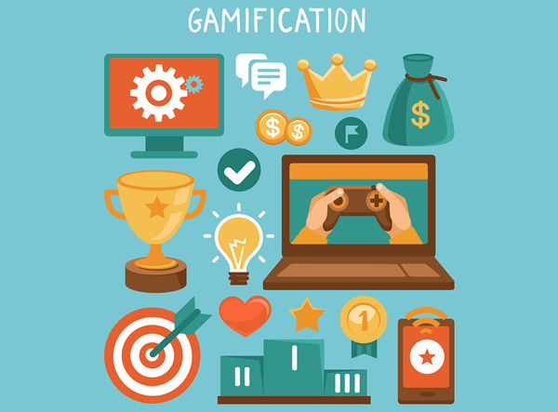
Outline for Presentation
Motivation
Why Gamification?
Game Background
Game Play
Summary

Slide 4
Key Definition
Cybersecurity: the protection of a computer data network from unauthorized [internal or external] theft, modification, destruction, disruption or disclosure.
Company executives revealed:
97% are concerned about cybersecurity
22% stated cybersecurity keeps them up at night
KPMG 2017 Survey

Slide 5
Motivation
The CEO of Delta Air Lines Was Asked What He Worries About Most. His Answer Will Truly Frighten Customers
www.inc.com

Slide 6
Motivation
Oil Prices Air Traffic Controllers
Unions
MAX 737 Cybersecurity
As planes are increasingly dependent on software, some fear the very systems that fly the planes could be subject to nefarious interference.

Slide 7
Generational Differences: Who are you…
The Silent Generation: born between 1927 - 1945
The Baby Boomers: born between 1946 - 1964
The Xers or Generation X : born between 1965-1980
Millennials; Gen-Y; Next Generation: born 1981 - 1995
Generation Z: born after 1995
Recent graduates
Current college students

Slide 8
Who is GenZ…
Rewards that are changed frequently to meet changing expectations and demands. Instant feedback.
Wants high intensity relationships with those in authority, as well as co-workers.
Connected all the time. Adopts technology at high levels & pushes others to same.
prefers communicating through images, icons and symbols.
Craves regular and technology-enhanced learning opportunities.

Slide 9
Knowing the New Workforce
Gen Z students tend to thrive when they are given the opportunity to have a fully immersive educational experience and they even enjoy the challenges of being a part of it.
51% of surveyed students said they learn best by doing
only 12% said they learn through listening.
enjoy class discussions and interactive classroom environments over the traditional dissemination teaching method.
Notes:
CHECK ARTICLE: How Generation Z Is Shaping The Change In Education
https://www.forbes.com/sites/sievakozinsky/2017/07/24/how-generation-z-is-shaping-the-change-in-education/#45819f996520
Generation Z has officially entered college. And just as the Millennials before them, this generation is disrupting the way learning happens in higher education. But these differences go beyond just a greater dependence on technology. Gen Z-ers tend to embrace social learning environments, where they can be hands-on and directly involved in the learning process. They expect on-demand services that are available at any time and with low barriers to access. And they tend to be more career-focused earlier on in their college careers.
A study done by Barnes and Noble College shows that today’s students refuse to be passive learners. They aren’t interested in simply showing up for class, sitting through a lecture, and taking notes that they’ll memorize for an exam later on. Instead, they expect to be fully engaged and to be a part of the learning process themselves.
In fact, Gen Z students tend to thrive when they are given the opportunity to have a fully immersive educational experience and they even enjoy the challenges of being a part of it. For instance, 51% of surveyed students said they learn best by doing while only 12% said they learn through listening. These same students also mentioned they tend to enjoy class discussions and interactive classroom environments over the traditional dissemination teaching method.
And the preference towards a collaborative learning environment isn’t just limited to in-person interactions. Instead, Gen Z is completely comfortable with learning alongside other students, even outside of their own school, using digital tools such as Skype and online forums.
And as a digital generation, Generation Z expects digital learning tools such as these to be deeply integrated into their education. For them, technology has always been a fully integrated experience into every part of their lives. And they don’t think education should be any different. They believe they should be able to seamlessly connect academic experiences to personal experiences through these same tools.
YOU MAY ALSO LIKE
Additionally, they expect that these learning tools be available on-demand and with low barriers to access. For them, learning isn’t limited to just the classroom; it’s something that can take place at any time, anywhere.
And finally, access to unlimited new information has created a more self-reliant and career driven generation. In fact, 13% of Gen Z-ers already have their own business. And many are even taking this entrepreneurial spirit to drive changes in college curriculum, as they show a strong interest in designing their own classroom path in college. For those who haven’t started a business quite yet, early preparation is still key. In fact, nearly half of high school students have taken at least one class that counts as college credit.
Part of this change is due to the fact that they have more access to more information than the generations before them. By the time they’ve reached higher ed, they are already well versed in current events, music popular culture, and global trends. They are well aware of the world around them and are already beginning to think through what their place in it will be.
Generation Z is leading the change in how learning takes place. They are a driving force in the innovation of new learning tools, teaching styles, and unlimited access to resources. And they are proving that college is headed in a direction of a more learner-centric environment where students will become the directors of their own futures.

Slide 10
21st Century Skills …
What skills do faculty need to build an effective learning environment:
Technical skills
Conceptual skills
Interpersonal skills

Slide 11
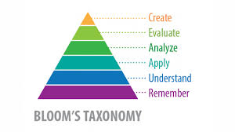
Game Approach
The game design relates to, underlies, & informs AIS Topics:
Reach higher levels of learning
Strategic Decision Making
Risk assessment and cybersecurity designs
Develop group-based competitive activities
Avoid complexity & complications of building data network
Leverage kinesthetic & experiential learning

Slide 12
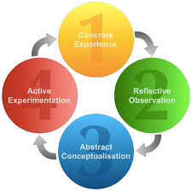
Experiential Learning
Experiential Learning
Experiential Action | Description | Cybersecurity Game Application
Do | Participate in a new experience | Research design options & types of attacks
Reflect | Reflect on observations and experiences | Post-Game Discussion
Think | Integrate observations | Create Preliminary Designs/Attacks
Act | Make decisions or solve problems | Game Day Decision-Making

Slide 13
Gamification
Gamification
Target Users for Competition
Challenge Objective for Activity
Game Rules & Structure Elements
Quantified Outcomes for Knowledge Gains
Gamification | Experiential Learning
Establish teams with diverse skillsets | Research design options & types of attacks
Score each Round Based on Strategy Outcome | Post-Game Discussion
Collaborate on Defense or Attack Strategies to meet Game Objectives | Create Preliminary Designs/Attacks
Play the Game | Game Day Decision-Making
*Game Scoring & Leaderboards Create a Competition

Slide 14
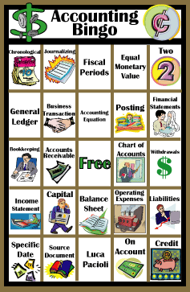
Game-Based Learning
Game Pattern for Instruction (Bloom’s Taxonomy):
Bingo (Remember)
Jeopardy (Remember)
Who Wants to be a Millionaire (Remember/Understand)
Monopoly (Understand/Apply)

Slide 15
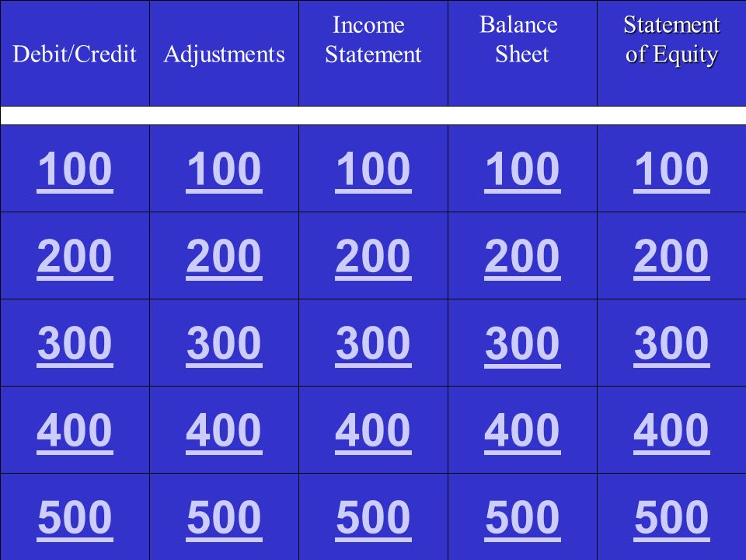
Game-Based Learning
Game Pattern for Instruction (Bloom’s Taxonomy):
Bingo (Remember)
Jeopardy (Remember)
Who Wants to be a Millionaire (Remember/Understand)
Monopoly (Understand/Apply)

Slide 16
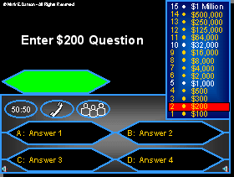
Game-Based Learning
Game Pattern for Instruction (Bloom’s Taxonomy):
Bingo (Remember)
Jeopardy (Remember)
Who Wants to be a Millionaire (Remember/Understand)
Monopoly (Understand/Apply)

Slide 17
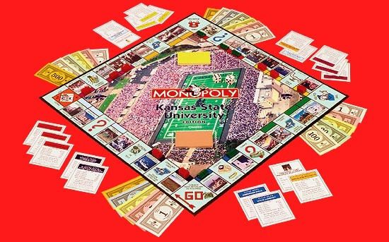
Game-Based Learning
Game Pattern for Instruction (Bloom’s Taxonomy):
Bingo (Remember)
Jeopardy (Remember)
Who Wants to be a Millionaire (Remember/Understand)
Monopoly (Understand/Apply)

Slide 18
Gamification: Competitive Game-Based Learning
Game Pattern for Instruction (Bloom’s Taxonomy):
Bingo (Remember)
Jeopardy (Remember)
Who Wants to be a Millionaire (Remember/Understand)
Monopoly (Understand/Apply)
Enterprise (ERP) Business Simulation (Apply/Analyze)

Slide 19
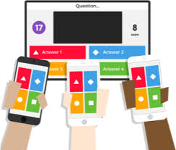
Gamification: Competitive Game-Based Learning
Game Pattern for Instruction (Bloom’s Taxonomy):
Bingo (Remember)
Jeopardy (Remember)
Who Wants to be a Millionaire (Remember/Understand)
Monopoly (Understand/Apply)
Enterprise (ERP) Business Simulation (Apply/Analyze)
Cybersecurity
Concepts learned by team competition (Apply/Analyze)

Slide 20
Team Competition as Prep Work
Use Texting from Phone
Team-based and Time sensitive
How to Play: Kahoot! (Supports text-based online quizzes and Games)

Slide 21
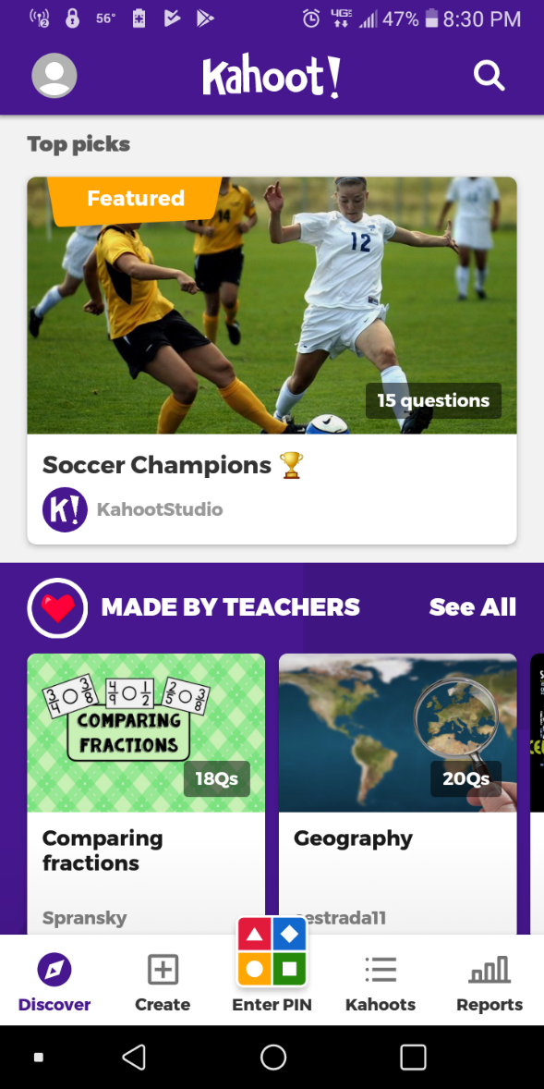
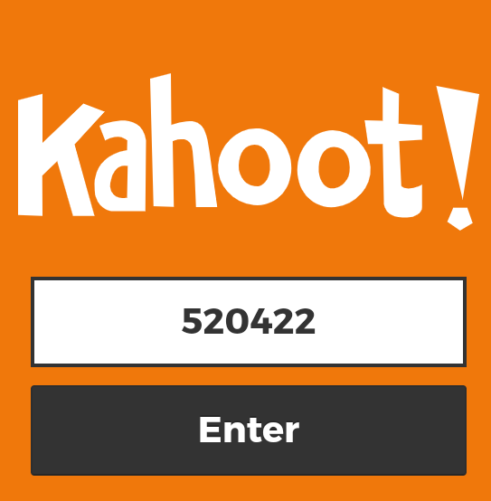
Let’s Play
Click Here to Enter PIN
Will be provided

Slide 22
Contribution
Collaborative decision making to enhance teamwork
Competitive game to engage GexZ new hires in cybersecurity
Scaffold cybersecurity knowledge
Avoid complexity and leverage gamification
Have fun with training!
Notes:
Reach higher levels of learning
Strategic Decision Making
Risk assessment and cybersecurity designs
Develop group-based competitive activities
Avoid complexity & complications of building data network
Leverage kinesthetic & experiential learning

