Slide 1
Robotic Process Automation
Hands-on Training and Tips on How to Introduce RPA to Your Students
Karen Kitching
703-993-9038
kkitchin@gmu.edu

Slide 2
Visit the following URL to obtain materials used in the webinar and other instructions resources:
CLICK HERE

Slide 3

Introduction
Advancements have been made. Audit and tax have changed.
With technology, there is no way to do work as was done in the past.
Michael Johnson
PwC, National Practice

Slide 4

Introduction
Business
Execs
Accountants
Coders
carbon based life form
hybrids
silicone based life form
Paulino Haro
GASB

Slide 5
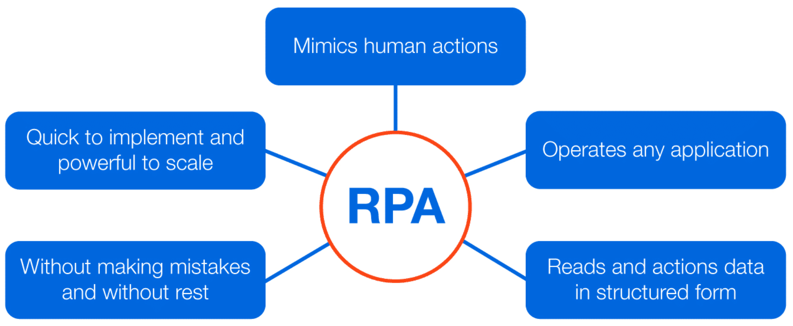
What is RPA?
Image from UiPath Starter Training, Lesson 3

Slide 6

Let’s build a bot!
Hands-on RPA!

Slide 7
Assignment Outcomes
Create variables
Learn logic functions
Code VB expressions
Have fun!
Scrape web pages

Slide 8
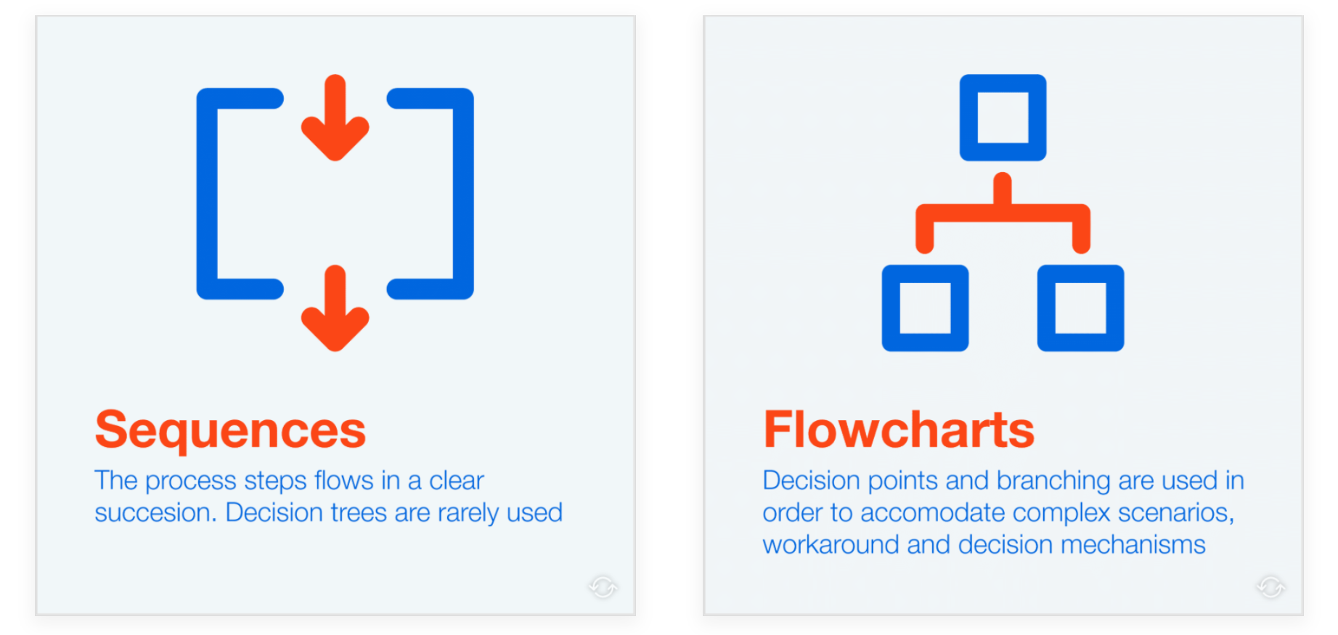
Sequences vs flowcharts
Image from UiPath Studio Guide
Notes:
See dialogue
When there are no decision points, all steps are mandatory and a sequence is the appropriate workflow.

Slide 9
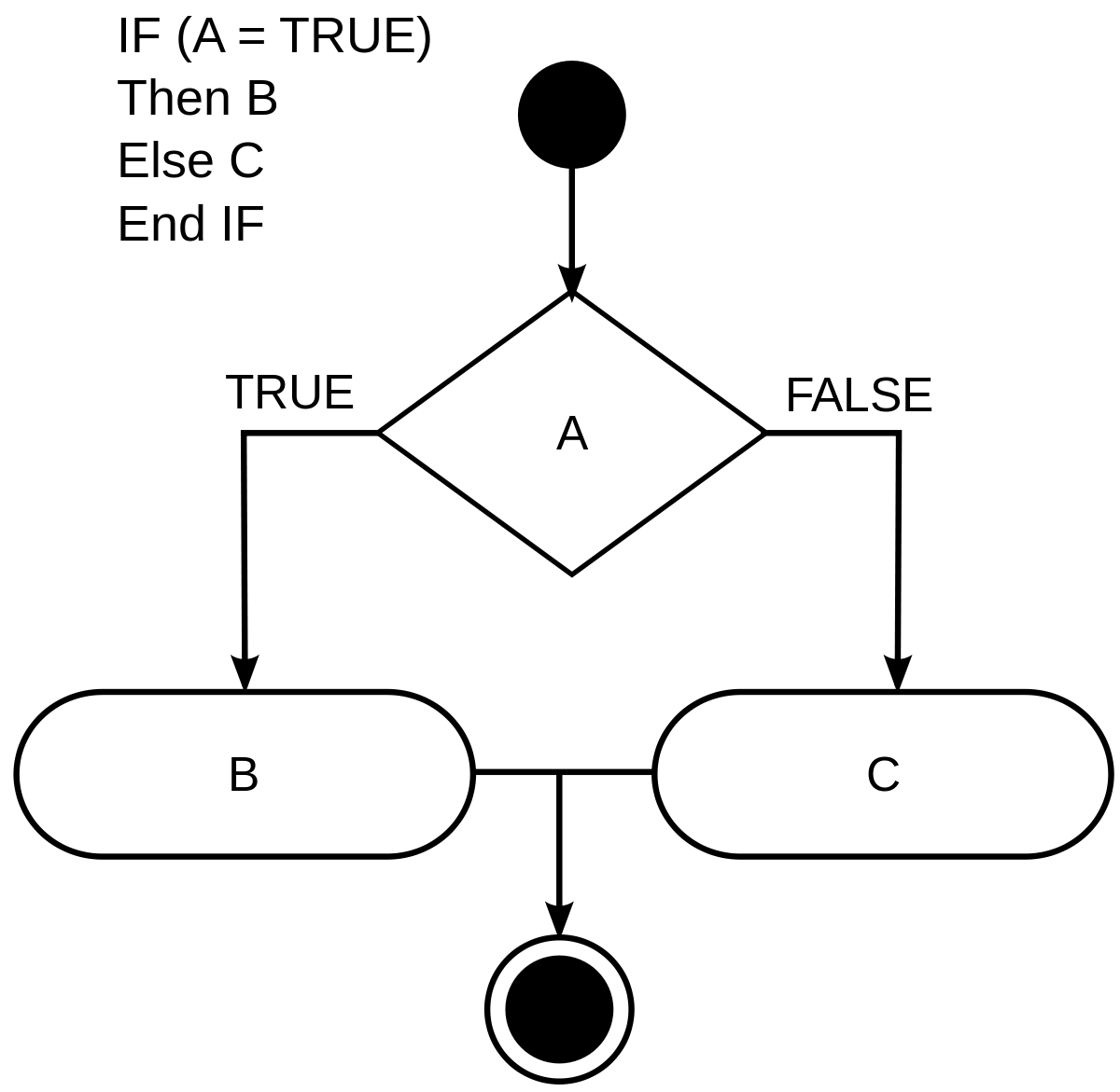
Logic Statements

Slide 10
Example RPA Capabilities
Logging onto enterprise applications
Receiving/opening/sending emails and attachments
Moving files and folders
Scraping data from the screen/web/pdf
Connecting to system interfaces
Following “if/then” decisions and rules
Copying and pasting data
Filling in forms
Merging data from multiple applications
Reading and writing to databases or spreadsheets
Searching, collating or updating information
Extracting, cleansing, and loading data into reports or dashboards
Extracting structured data from documents
Performing complex algorithms

Slide 11
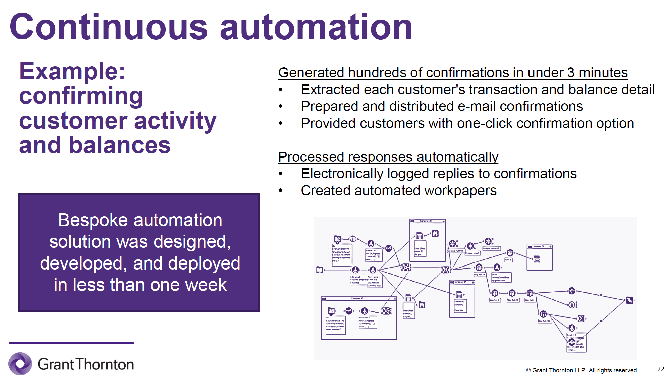
Example: AR Confirmations
https://www.grantthornton.com/events/audit/2019/04-11-audit-innovation-has-arrived.aspx

Slide 12
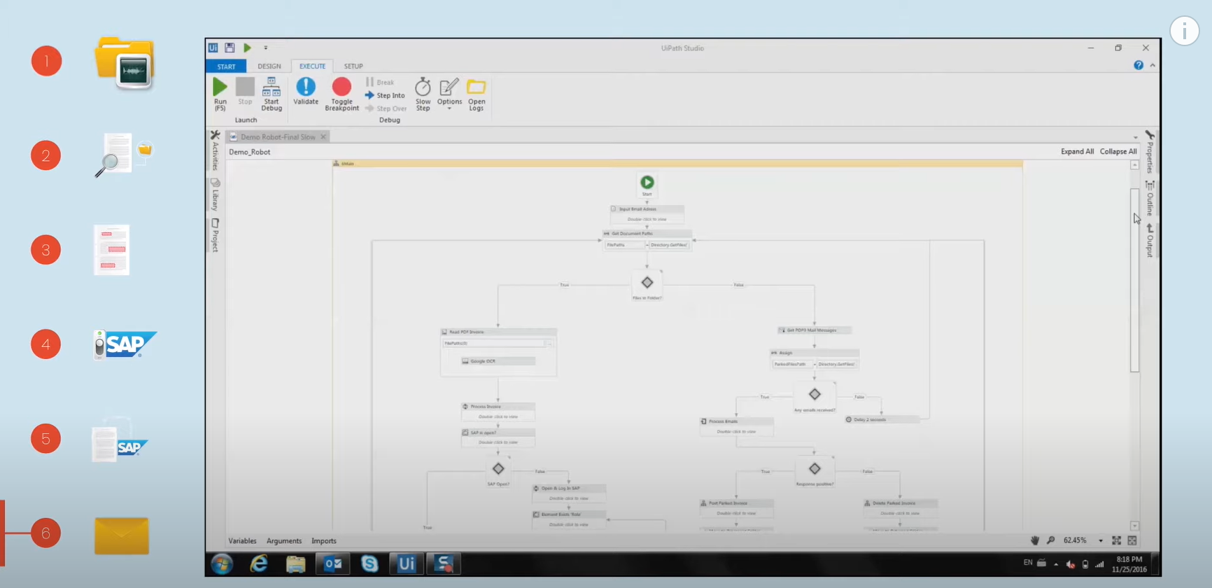
Example: Vendor Invoice Processing
Visit the following URL for demo links: CLICK HERE

Slide 13
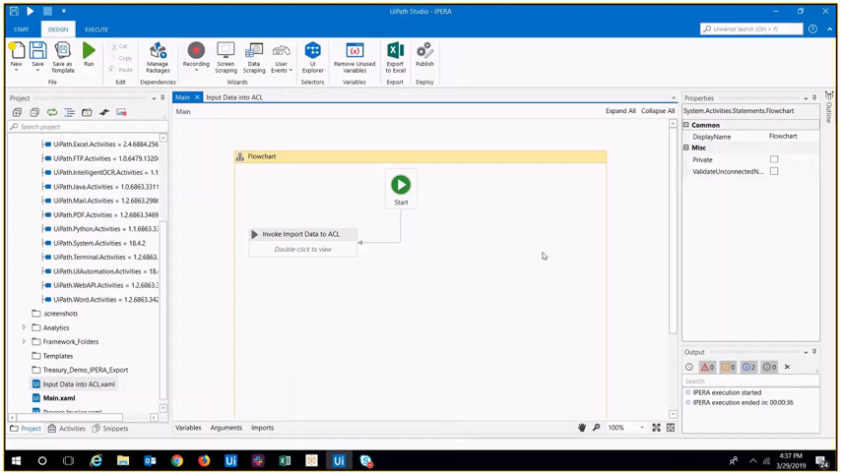
Kearney & Company IPERA Solution

Slide 14
Teaching Resources
Lesson materials and free courses
Accounting professionals
Education journals
UiPath Academy
Accounting firms (such as EY ARC)

Slide 15
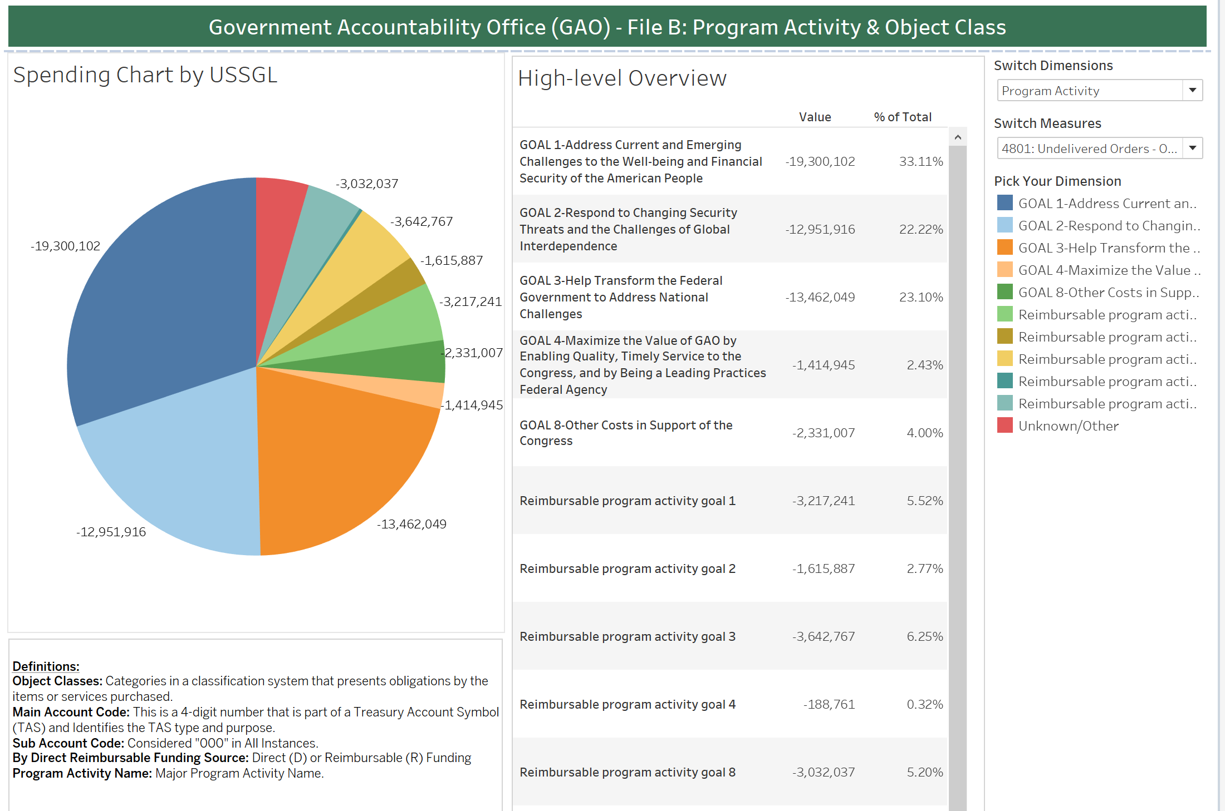
U.S. DATA Act Visualization Case

Slide 16
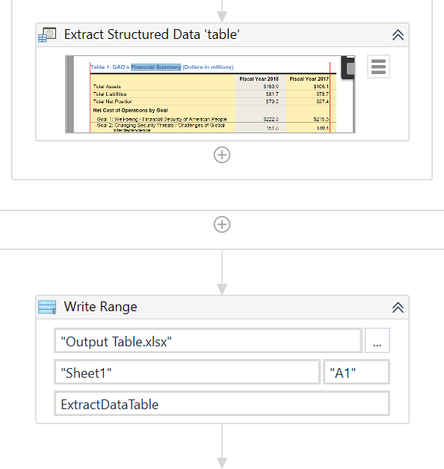
U.S. DATA Act RPA Case

Slide 17
Conclusion
It’s hard to keep up with technology . . .
so much change; rapid adoption; a continuous training scenario
Karen Kitching
George Mason University

Slide 18
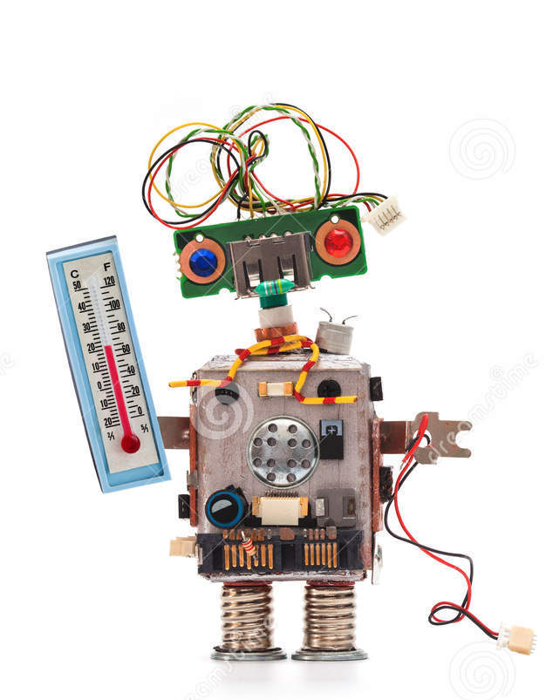
Thank You!
Image from cartoondealer.com

