Slide 1
Teaching Systems Documentation Skills and Database Concepts
AIS Bootcamp 2017
Cheryl Dunn
Grand Valley State University
Laura Kline
Ernst & Young

Slide 2
System Documentation for Modeling Workflow: Which tool to teach?
The tool is not what is most important – rather, helping students to understand how data gets from its sources to the financial statements is what is crucial
Can they read a flowchart, DFD, activity diagram, BPMN diagram, or even a narrative, and tell how the data is getting to the financial statements
  If not, can they ask the right questions to gain the understanding they need?
  Do they understand where the risks are and what controls will help mitigate those risks?

Slide 3
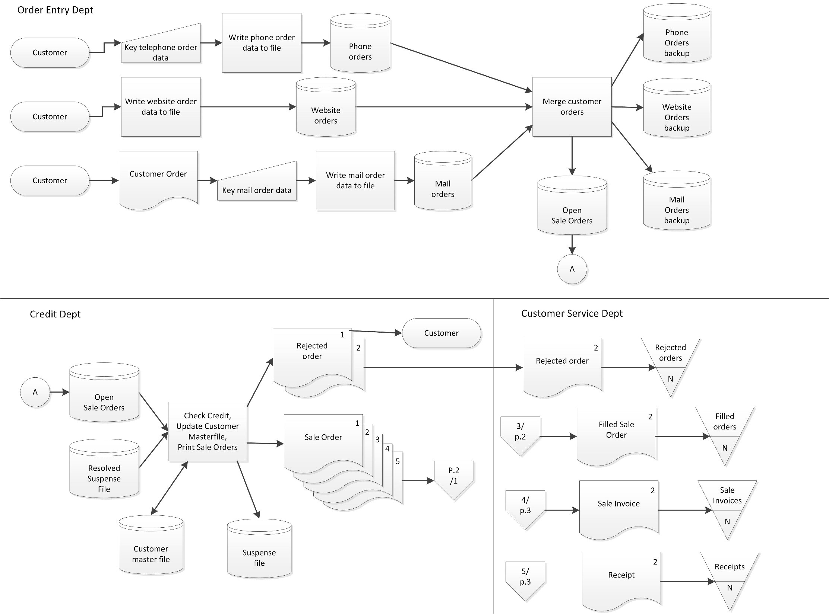

Slide 4
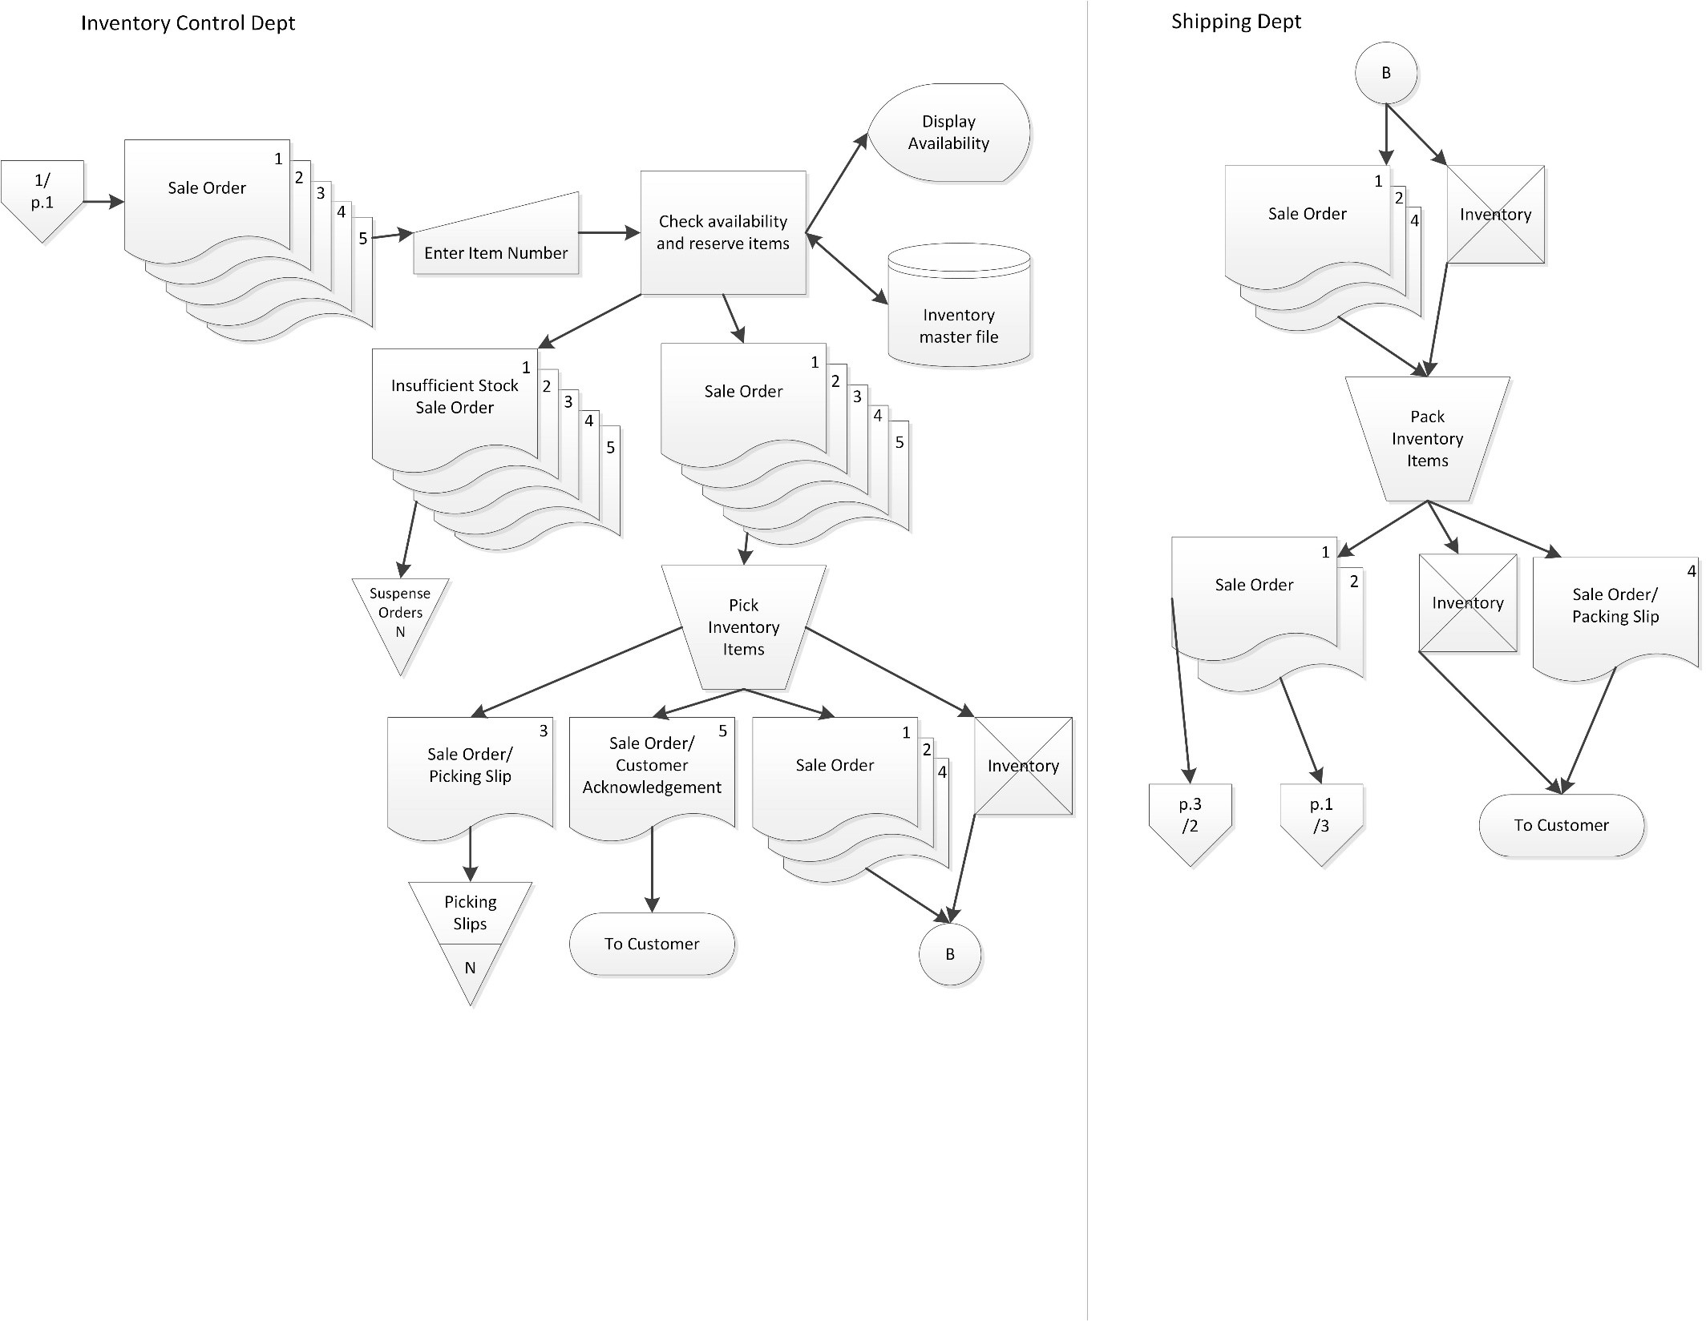

Slide 5
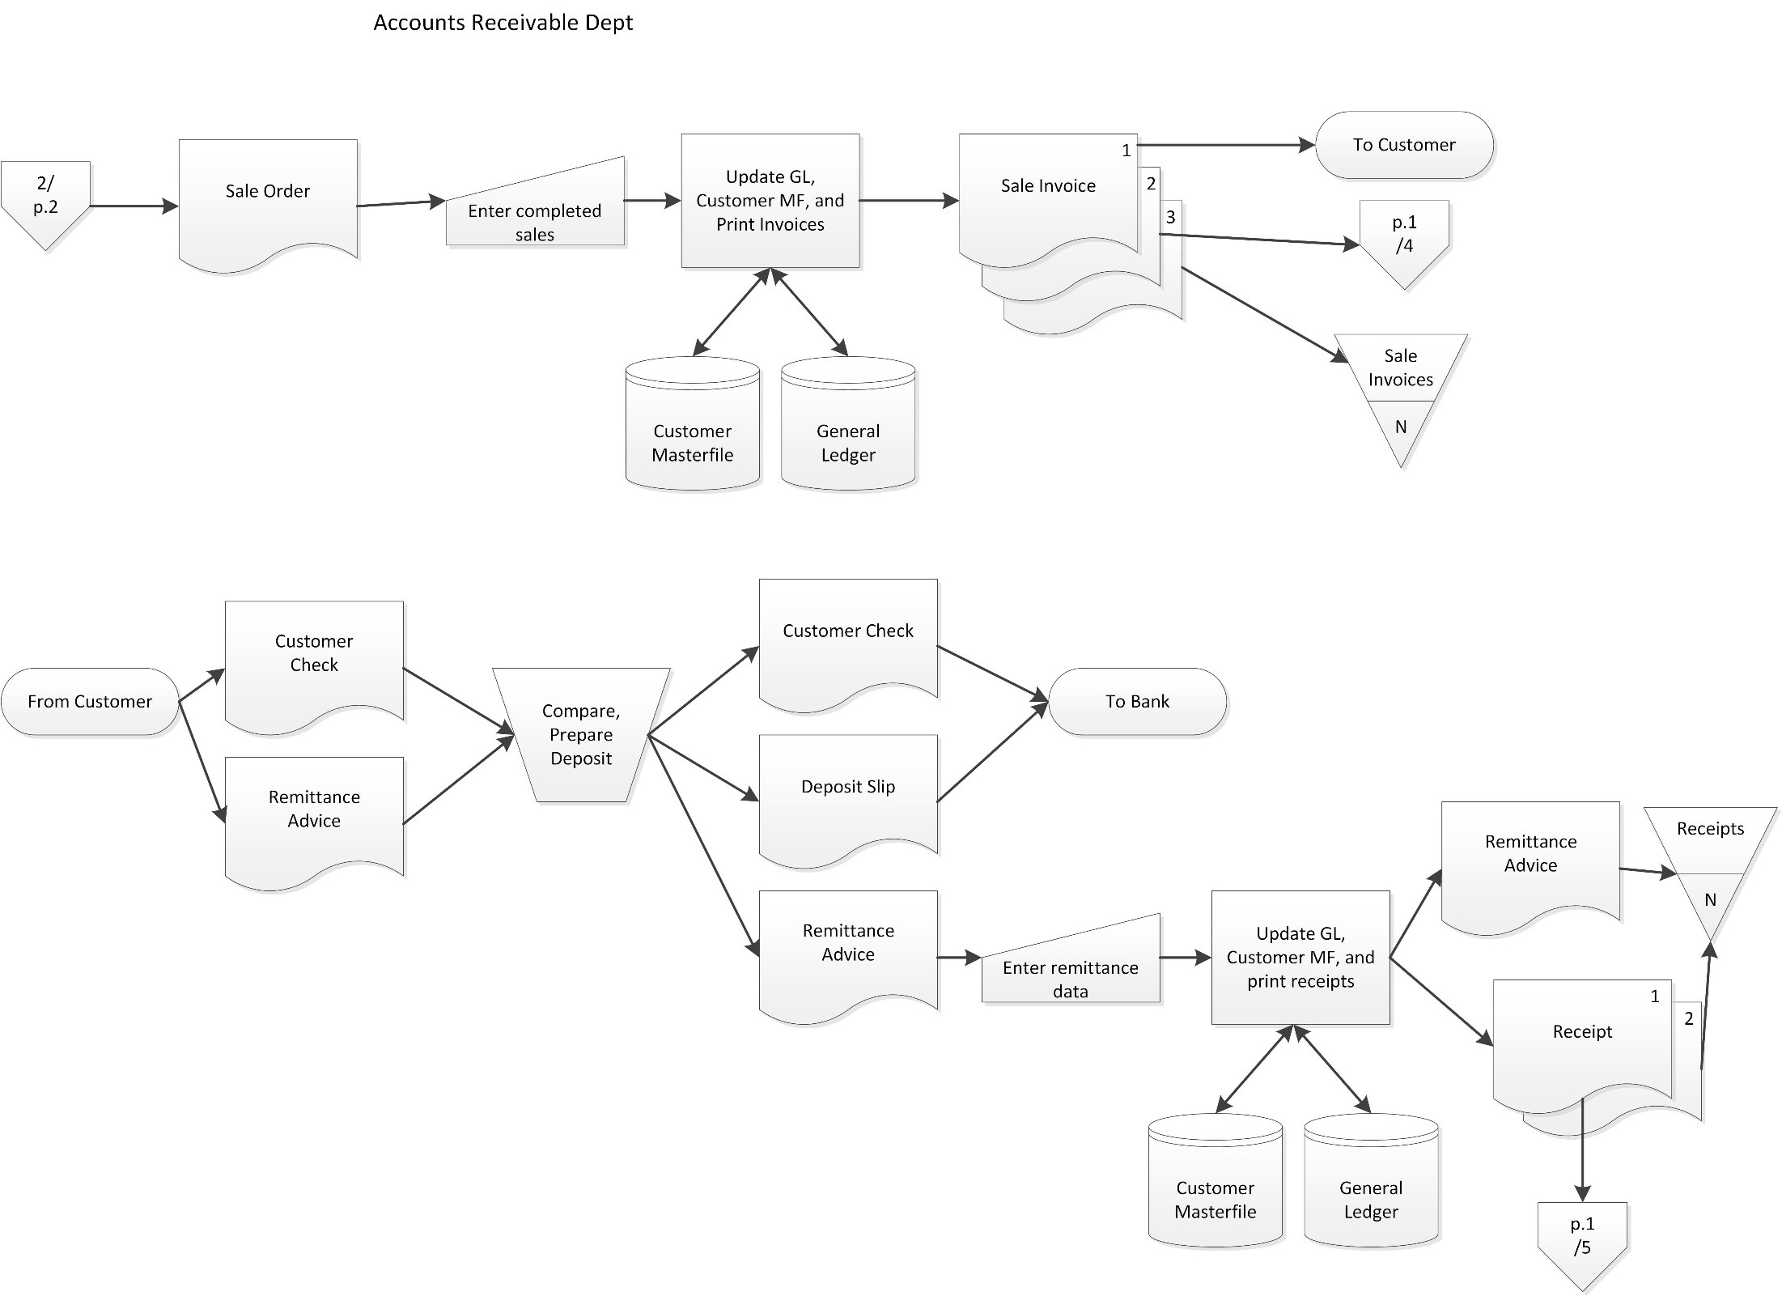

Slide 6
Database Concepts: REA
Resources-Events-Agents
  A design pattern for enterprise systems
  A great way to understand business processes and ERP systems
  To understand how to extract data, students must understand how it is stored – which requires at least the rudiments of database design
  Timeless - implement in any database environment using any conceptual modeling format: E-R diagrams, UML class diagrams, triple-store databases, AI languages
  Promotes pattern-based thinking and modeling reality with symbols – pairing abstract with concrete – good for critical thinking

Slide 7
Accounting Through The Ages
Principal
Enterprise Economic Activities (Give & Take)
“ transactional memory external to the parties of the exchange”
Economic storytelling with semantic models of value creation by firms
Economic storytelling of interoperable communities of firms
memorandum
source
jar
document
Surrogates
notched
Journal
.
computer
Collaboration Space
stick
A/
Rec
….
files and
Sales…
General
Financial
Other
Ledger
Reporting View
Views of
Enterprise
Event-chains
Ledger
.
Financial
ooo
statements
Agrarian Age
Mercantile Age
Industrial Age
Enterprise Systems Age
Semantic Web Age

Slide 8
Teaching with REA encourages students to be economic storytellers/historians/reporters – telling a more complete history of enterprise activities.
Who? What? Where? When? Why? How Big? How Much? Due When? How Long? How Good?

Slide 9
REA Expands the Time Scope of the Storytelling
What could be or should be
Rtype
Etype
Atype
( the future )
What is planned or scheduled
Rtype
Etype
Commit
Event
Atype
( the foreseeable present )
What actually occurred
Resource
Event
Agent
( the past & near present )

Slide 10
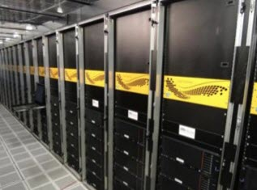
The Game Has Changed!
Technology Advances mean businesses could generate all the information needed for GAAP reporting from the raw transaction data – no general ledger is needed!

Slide 11
The Game Has Changed!
Many businesses today have huge blind spots because of aggregation
  E.g. aggregate individual products into categories for analysis – one product’s increases cancel out another product’s decreases, leading the company to miss out on opportunity to maximize profit
Don’t expect this to last much longer with this technology!

Slide 12
The Application Challenge per Mark Nittler, Workday
Operational View of a Sale
Financial Accounting View of a Sale

Slide 13
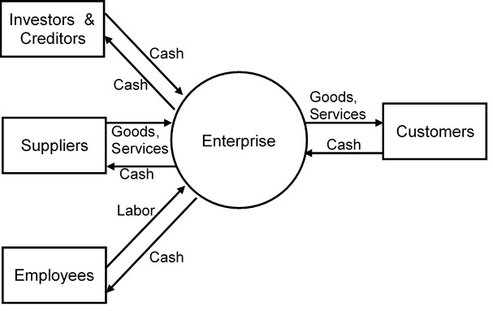
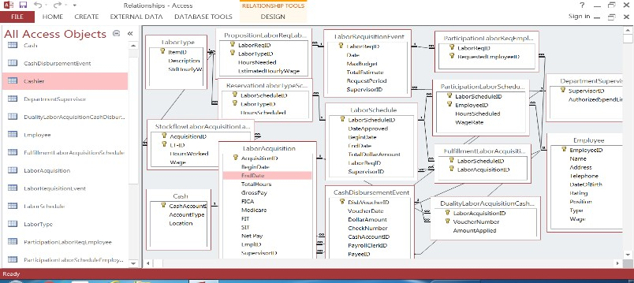
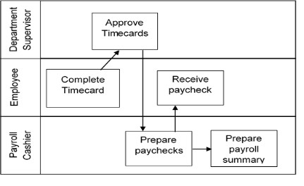
REA – 4 levels
Value Chain Level
Value System Level
Business Process Level
Task Level

Slide 14
Symbol Representations at Different Levels of Abstraction
Token level SYMBOL
Type level SYMBOL
REALITY
Representation at the type level uses one symbol for multiple instances of a specified type
green
red
Color
blue
yellow
Representation at the token level has a separate symbol for each specific instance in reality
purple
Source: Professor Bill McCarthy at Michigan State University; based on Geerts and McCarthy, “An Ontological Analysis of the Economic Primitives of the Extended-REA Enterprise Information Architecture” International Journal of Accounting Information Systems. 3:21. 1-16.

Slide 15
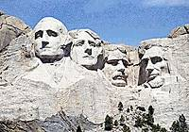
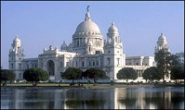
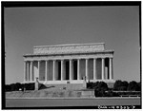
Are the objects below symbols or reality?
Are they “token” or “type” level objects?
Can you match the left-side objects to the corresponding right-side objects?
Victoria Memorial Hall
Lincoln Memorial
Mount Rushmore

Slide 16
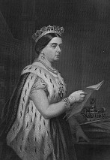
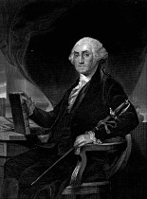
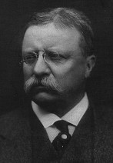
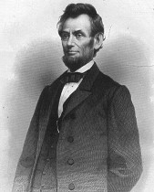
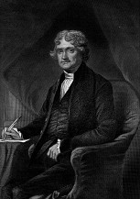
Queen George Theodore Abraham Thomas
Victoria Washington Roosevelt Lincoln Jefferson
Are these objects symbols or reality?
Are they “token” or “type” level objects?
Can you match these objects to those on the previous slide?

Slide 17
Landmark
  Name
  Location
  Yr Finished
Famous Person
  Name
  Birth
  Death
for
Landmark
Famous Person
Name | Location | Yr Finished
Victoria Memorial | Calcutta | 1921
Lincoln Memorial | Washington DC | 1922
Mount Rushmore | Rapid City | 1941
Name | Birth | Death
Thomas Jefferson | 1743 | 1826
Abraham Lincoln | 1809 | 1865
Theodore Roosevelt | 1858 | 1919
George Washington | 1732 | 1799
Queen Victoria | 1819 | 1901
How might we represent the “for” relationship in the tables?

Slide 18
Choice 1: Add column to Landmark table
Landmark
Name | Location | Yr Finished | For Famous Person Named
Victoria Memorial | Calcutta | 1921 | Queen Victoria
Lincoln Memorial | Washington DC | 1922 | Abraham Lincoln
Mount Rushmore | Rapid City | 1941 | Abraham Lincoln, George Washington, Thomas Jefferson, Theodore Roosevelt
Famous Person
Name | Birth | Death
Thomas Jefferson | 1743 | 1826
Abraham Lincoln | 1809 | 1865
Theodore Roosevelt | 1858 | 1919
George Washington | 1732 | 1799
Queen Victoria | 1819 | 1901

Slide 19
Choice 2: Add column to Famous Person table
Landmark
Name | Location | Yr Finished
Victoria Memorial | Calcutta | 1921
Lincoln Memorial | Washington DC | 1922
Mount Rushmore | Rapid City | 1941
Famous Person
Name | Birth | Death | Landmark For
Thomas Jefferson | 1743 | 1826 | Mount Rushmore
Abraham Lincoln | 1809 | 1865 | Lincoln Memorial, Mount Rushmore
Theodore Roosevelt | 1858 | 1919 | Mount Rushmore
George Washington | 1732 | 1799 | Mount Rushmore
Queen Victoria | 1819 | 1901 | Victoria Memorial Hall

Slide 20
Choice 3: Create a 3rd table
Landmark
Famous Person
Name | Location | Yr Finished
Victoria Memorial | Calcutta | 1921
Lincoln Memorial | Washington DC | 1922
Mount Rushmore | Rapid City | 1941
Name | Birth | Death
Thomas Jefferson | 1743 | 1826
Abraham Lincoln | 1809 | 1865
Theodore Roosevelt | 1858 | 1919
George Washington | 1732 | 1799
Queen Victoria | 1819 | 1901
Landmark for Famous Person
Landmark Name | Person Name
Victoria Memorial | Queen Victoria
Lincoln Memorial | Abraham Lincoln
Mount Rushmore | Abraham Lincoln
Mount Rushmore | George Washington
Mount Rushmore | Thomas Jefferson
Mount Rushmore | Theodore Roosevelt

Slide 22
Customer
Customer_ID | CustomerName | CreditRating | StreetAddress | City | AssignedSP
C0000001 | Office Extreme | A- | 123 Elm | Bedrock | E00008
C0009032 | Educator Source | A+ | 45 Birch | Tally | E00002
C0000715 | Gibby’s | B | 62 Tiger | Detro | E00002
C0001012 | Office Station | A- | 452 Clip | Lance | E00011
C0000047 | Supply Circuit | A+ | 271 City | Tally | E00011
C0010230 | Henry’s | B+ | 24 Plot | Lance | E00002
C0008643 | Books-n-more | A | 33 Park | Tally | E00008
C0003521 | EverythingPlus | B | 147 Mahan | Bedrock | E00002
Salesperson
Employee
Employee_ID | CommissionRate
E00002 | .0125
E00008 | .0150
E00011 | .0115
EmployeeID | FirstName | LastName | City | Street | HourlyPay | YearBorn | Title
E00001 | Ned | Cook | Bath | 48 Oak | $65.00 | 1962 | President
E00002 | Mary | Gerard | Tally | 12 Beech | $32.45 | 1970 | Sales
E00003 | Caitlyn | Joseph | Tally | 57 Maple | $28.70 | 1992 | VP Advertising
E00004 | Greg | McCarthy | Tally | 91 South | $45.20 | 1969 | Controller
E00005 | Bill | Scott | Bath | 133 Elm | $57.15 | 1950 | CFO
E00006 | Martha | Simmett | Detro | 452 1st | $17.52 | 1965 | Custodian
E00007 | Larry | Stout | Lance | 921 Wood | $15.50 | 1960 | Cashier
E00008 | Joe | Wilcox | Detro | 452 1st | $32.30 | 1963 | Sales
E00009 | Rich | Wrong | Detro | 103 North | $16.25 | 1962 | Asst Custodian
E00010 | Sue | Hubbard | Lance | 198 West | $25.50 | 1964 | Accountant I
E00011 | Jim | Wood | Bath | 882 Scott | $33.10 | 1962 | Sales
E00012 | Sarah | James | Bath | 77 Oak | $18.95 | 1994 | Accountant II
E00013 | Carrie | Bychek | Tally | 38 Lake | $15.50 | 1959 | Cashier
Cashier
Employee_ID | FidelityBondRating
E00007 | B+
E00013 | A

Slide 23
Inventory Type
Inventory
SKU | Description | StdUnitCost
CP05 | Copier paper, 5 ream case | $10.00
CP10 | Copier paper, 10 ream case | $20.00
DE01 | Dry erase markers, 4 pk, multi-colors | $2.00
GB1 | Glassboard, 3’ x 4’, on metal stand | $140.00
GB2 | Glassboard, 4’ x 6’, on metal stand | $480.00
MF17 | Microfiber cleaning cloth, 2 pk | $6.00
PM16 | Paint markers, 4pk, primary colors | $3.00
PM17 | Paint markers, 4pk, neon colors | $3.00
PN42 | Post-it notes, 12 pk 3”x4” | $4.00
QC24 | Quandrax desktop computer | $220.00
QC24L | Quandrax laptop computer | $350.00
X4005 | Copy machine, light duty | $1,200.00
X9002 | Copy machine, heavy duty | $4,500.00
SerialNumber | DateManufactured | ActualCost | SKU
8316YW-31569 | 1/15/2017 | 220.00 | QC24
3516YK-63189 | 1/15/2017 | 220.00 | QC24
7783YF-43175 | 1/15/2017 | 220.00 | QC24
1235YG-13265 | 3/1/2017 | 225.00 | QC24
3153YZ-31569 | 3/5/2017 | 225.00 | QC24
7315YL-31590 | 3/5/2017 | 225.00 | QC24
6315YJ-13256 | 3/5/2017 | 225.00 | QC24
9315YP-93561 | 3/1/2017 | 225.00 | QC24
8315YQ-83156 | 3/7/2017 | 225.00 | QC24
3153YJ-53168 | 4/29/2017 | 218.00 | QC24
3125LP-50276 | 1/20/2017 | 348.00 | QC24L
8751LQ-31056 | 1/20/2017 | 348.00 | QC24L
7442LU-17325 | 2/28/2017 | 355.00 | QC24L
8315LP-51265 | 4/10/2017 | 358.00 | QC24L
4725LY-53165 | 5/01/2017 | 345.00 | QC24L
3215LK-63158 | 5/01/2017 | 345.00 | QC24L
7214LJ-42186 | 5/01/2017 | 345.00 | QC24L
8829LS-90987 | 5/01/2017 | 345.00 | QC24L
81Xu3112-31 | 1/20/2017 | 1210.00 | X4005
44Xyj915-274 | 2/15/2017 | 1195.00 | X4005
73Xygq1-486 | 2/15/2017 | 1195.00 | X4005
34Xasb8-729 | 2/15/2017 | 1195.00 | X4005
48Xaseq-1235 | 3/18/2017 | 1203.00 | X4005
9731Xu4-3216 | 1/27/2017 | 4,498.00 | X9002
7908Xy31-884 | 3/04/2017 | 4,555.00 | X9002
Cash
AccountID | Type | Location
1 | Savings | First Bank
2 | Petty | Room 102
3 | Imprest | First Bank
4 | Money Market | First Bank
5 | Checking | First Bank
6 | Savings | American Bank

Slide 24
Sales Call
SC_ID | SC_Date | Nbr_Items_Presented | Overall_Reception | Customer_ID | Salesperson_ID
SC171 | 04/02/2017 | 2 | Favorable | C0000001 | E00008
SC185 | 04/02/2017 | 2 | Neutral | C0000715 | E00002
SC201 | 04/09/2017 | 3 | Favorable | C0009032 | E00002
SC222 | 04/12/2017 | 2 | Unfavorable | C0000001 | E00008
SC234 | 04/12/2017 | 2 | Favorable | C0001012 | E00011
SC410 | 04/20/2017 | 3 | Neutral | C0000047 | E00011
SC502 | 04/29/2017 | 2 | Favorable | C0010230 | E00002
SC617 | 05/01/2017 | 3 | Favorable | C0009032 | E00002
SC620 | 05/01/2017 | 2 | Favorable | C0000001 | E00008

Slide 25
Proposition
SC_ID | SKU | Quoted_Sell_Price | Customer_Reaction
SC171 | GB1 | $310 | Ordered on the spot
SC171 | PM17 | $9 | Ordered on the spot
SC185 | X4005 | $2,250 | Unsure if rugged enough, but maybe
SC185 | X9002 | $9,420 | Too expensive, but nice machine
SC201 | GB2 | $940 | Likes a lot, concerned about price
SC201 | DE01 | $5 | Will probably buy next month
SC201 | MF17 | $15 | Will probably buy next month
SC222 | X4005 | $2,250 | Not impressed at all
SC222 | MF17 | $15 | Likes for cleaning glassboard bought but didn’t order
SC234 | X4005 | $2,250 | Ordered on the spot
SC234 | X9002 | $9,420 | Ordered on the spot
SC410 | GB1 | $300 | Not sure – likes some things, may be too small
SC410 | MF17 | $15 | Cleans well, pricy for a simple cloth
SC410 | PM17 | $9 | Interested, depends on whether buys the GB1
SC502 | QC24 | $450 | Ordered on the spot
SC502 | QC24L | $750 | Ordered on the spot
SC502 | GB1 | $310 | Not sure
SC617 | GB1 | $300 | Liked, not yet ready to order
SC617 | QC24 | $450 | Liked, not yet ready to order
SC617 | PM17 | $9 | Liked, not yet ready to order
SC620 | QC24 | $460 | Will likely order soon
SC620 | QC24L | $780 | Will likely order soon

Slide 26
Sale Order
SO_ID | SO_Date | SO_Amount | ShippingCharge | Customer_ID | Salesperson_ID
SO97 | 04/02/2017 | $5,200.00 | $145.00 | C0000001 | E00008
SO142 | 04/12/2017 | $14,000.00 | $80.00 | C0001012 | E00011
SO210 | 04/29/2017 | $2,500.00 | $100.00 | C0010230 | E00002
SO244 | 04/30/2017 | $340.00 | $30.00 | C0010230 | E00002
SO252 | 05/02/2017 | $6,680.00 | $150.00 | C0009032 | E00002
SO265 | 05/05/2017 | $3,500.00 | $100.00 | C0000001 | E00008
SO321 | 05/08/2017 | $8,220.00 | $160.00 | C0000047 | E00011
Reservation
SO_ID | SKU | Ordered_Quantity | Ordered_Sell_Price
SO97 | GB1 | 10 | $310.00
SO97 | PM17 | 20 | $9.00
SO97 | CP10 | 50 | $34.00
SO97 | PN42 | 15 | 5.00
SO142 | X4005 | 2 | $2,250.00
SO142 | X9002 | 1 | $9,420.00
SO210 | QC24 | 2 | $450.00
SO210 | QC24L | 2 | $750.00
SO244 | GB1 | 1 | $310.00
SO252 | GB1 | 10 | $300.00
SO252 | PM17 | 20 | $9.00
SO252 | CP10 | 100 | $20.00
SO252 | QC24 | 3 | $450.00
SO265 | QC24 | 4 | $460.00
SO265 | QC24L | 2 | $780.00
SO321 | GB1 | 10 | $300.00
SO321 | GB2 | 5 | $940.00
SO321 | MF17 | 15 | $15.00
SO321 | PM17 | 15 | $9.00
FulfillmentSCSO
SC_ID | SO_ID
SC171 | SO97
SC234 | SO142
SC502 | SO210
SC502 | SO244
SC617 | SO252
SC620 | SO265

Slide 27
Sale
Sale_ID | Sale_Date | Sale_Amount | Shipping Terms | Payment Terms | SO_ID | Customer_ID | Salesperson_ID
S102 | 04/06/2017 | $4,820.00 | Fob destination | 1/10, n/30 | SO97 | C0000001 | E00008
S156 | 04/15/2017 | $14,000.00 | Fob shipping | 2/10, n/30 | SO142 | C0001012 | E00011
S221 | 05/03/2017 | $2,500.00 | Fob destination | n/30 | SO210 | C0010230 | E00002
S260 | 05/04/2017 | $340.00 | Fob shipping | 2/10, n/30 | SO244 | C0010230 | E00002
S265 | 05/04/2017 | $330.00 | Fob shipping | 2/10, n/30 | SO97 | C0000001 | E00008
S277 | 05/05/2017 | $6,680.00 | Fob shipping | 2/10, n/30 | SO252 | C0009032 | E00002
S291 | 05/06/2017 | $2,200.00 | Fob shipping | 2/10, n/30 | SO265 | C0000001 | E00008
S317 | 05/08/2017 | $1,200.00 | Fob shipping | 2/10, n/30 | SO265 | C0000001 | E00008

Slide 28
StockflowITS
StockflowIS
SKU | Sale_ID | Quantity_Sold | Actual_Sell_Price
GB1 | S102 | 10 | $310.00
PM17 | S102 | 20 | $9.00
CP10 | S102 | 40 | $33.00
PN42 | S102 | 15 | $5.00
X4005 | S156 | 2 | $2,250.00
X9002 | S156 | 1 | $9,420.00
QC24L | S221 | 2 | $750.00
QC24 | S221 | 2 | $450.00
GB1 | S260 | 1 | $310.00
CP10 | S265 | 10 | $33.00
GB1 | S277 | 10 | $300.00
PM17 | S277 | 20 | $9.00
CP10 | S277 | 100 | $20.00
QC24 | S277 | 3 | $450.00
QC24 | S291 | 3 | $450.00
QC24L | S291 | 1 | $750.00
QC24 | S317 | 1 | $450.00
QC24L | S317 | 1 | $750.00
Serial_Number | Sale_ID | Actual_Sell_Price
81Xu3112-31 | S156 | $2,250.00
44Xyj915-274 | S156 | $2,250.00
9731Xu4-3216 | S156 | $9,420.00
3125LP-50276 | S221 | $750.00
8751LQ-31056 | S221 | $750.00
8316YW-31569 | S221 | $450.00
3516YK-63189 | S221 | $450.00
1235YG-13265 | S277 | $450.00
3153YZ-31569 | S277 | $450.00
7315YL-31590 | S277 | $450.00
6315YJ-13256 | S291 | $450.00
9315YP-93561 | S291 | $450.00
8315YQ-83156 | S291 | $450.00
8315LP-51265 | S291 | $750.00
3153YJ-53168 | S317 | $450.00
4725LY-53165 | S317 | $750.00

Slide 29
Cash Receipt
CR_ID | CR_Date | CR_Amount | Cash_Acct_ID | Cashier_ID | Customer_ID
CR1 | 01/01/2017 | $350,000.00 | 4 | E00007
CR2 | 01/01/2017 | $150,000.00 | 5 | E00007
CR121 | 04/24/2017 | $13,720.00 | 5 | E00013 | C0001012
CR145 | 04/29/2017 | $4,820.00 | 5 | E00013 | C0000001
CR170 | 05/08/2017 | $8,220.00 | 5 | E00013 | C0000047
CR179 | 05/13/2017 | $6,370.00 | 5 | E00013 | C0009032
CR188 | 05/15/2017 | $3,332.00 | 5 | E00007 | C0000001
CR196 | 05/15/2017 | $330.00 | 5 | E00007 | C0000001
Duality
Sale_ID | CR_ID | Amount_Applied | Sale_Discount
S156 | CR121 | $14,000.00 | $280.00
S102 | CR145 | $4,820.00 | $0.00
S265 | CR196 | $330.00 | $0.00
S277 | CR179 | $6,500.00 | $130.00
S291 | CR188 | $2,200.00 | $44.00
S317 | CR188 | $1,200.00 | $24.00
Fulfillment SOCR
SO_ID | CR_ID | Amount_Applied
SO97 | CR145 | $4,820.00
SO97 | CR196 | $330.00
SO142 | CR121 | $14,000.00
SO321 | CR170 | $8,220.00

Slide 30
Sale Return
SaleReturn_ID | SaleReturn_Date | SaleReturn_Amount | Customer_ID | Salesperson_ID
SR17 | 5/10/2017 | $750.00 | C0010230 | E00002
SR18 | 05/11/2017 | $180.00 | C0009032 | E00002
ReversalSSR
Sale_ID | SaleReturn_ID | Return_Amount_Applied
S221 | SR17 | $750.00
S277 | SR18 | $180.00
StockflowISR
SerialNumber | SaleReturn_ID | UnitPriceCredited
3125LP-50276 | SR17 | $750.00
StockflowITSR
SKU | SaleReturn_ID | UnitPriceCredited | QuantityReturned
QC24L | SR17 | $750.00 | 1
PM17 | SR18 | $9.00 | 20

Slide 31
Net Sales April 11 – May 10, 2017
Sales Revenue April 11 – May 10, 2017 = $27,250 (sum sale amount column in sale table for sale dates in that range)
Sales Returns April 11 – May 10, 2017 = $750 (sum sale return amount column in sale return table for sale return dates in that range)
Sales Discounts April 11 – May 10, 2017 = $280 (combine DualitySCR table with Cash Receipt and Sales tables to find Cash receipts received in that date range applicable to sales made prior to May 10 and sum those meeting the criteria in the Discount Amount column in the DualitySCR table)
Net Sales April 11 – May 10, 2017 = $27,250 - $750 - $280 = $26,220

Slide 32
Accounts Receivable as of May 10, 2017
Cumulative Net Sales through May 10, 2017
  Similar procedures to prior slide, just different date constraints
  Gross sales through 5/10/2017 = $32,070
  Returns through 5/10/2017 = $750
  Discounts through 5/10/2017 = $280
  Net Sales through 5/10/2017 = $32,070 - $750 - $280 = $31,040
Cash Receipts Applied to Sales through May 10, 2017 = $18,820
  (sum amount applied column in DualitySCR table after joining DualitySCR to Cash Receipts table and constraining the cash receipt date to be <= May 10)
Accounts Receivable = $31,040 - $18,820 = $12,220

Slide 33
Unearned Revenue as of May 10, 2017
Cash Receipts applicable to sale orders that were unfulfilled as of May 10
Use Cash Receipts, Fulfillment SOCR, Sales Order, and Sale
Sum Amount Applied from Fulfillment SOCR after joining FulfillmentSOCR to Cash Receipts where CR date <= May 10, 2017 and subtract any related Sale amounts (joining on SO_ID) where Sale date <= May 10, 2017
$27,370 - $19,150 = $8,220

Slide 34


0
10
11
1
0
0
1
1
What is EY Helix
1
10
1
10
Helix
0
1
0
0
10
Unlocking the power of analytics in the audit
https://www.youtube.com/watch?v=81W-ITN2wWg
1
1
1
10
Our suite of data and analytics offerings designed to assist in providing high-quality audits and insights to our clients
0
0
0
1
0
Globally consistent | Sector aligned | Account focused | Meaningful insights | Issue driven | Dynamic
1
1
10
Methodology integrated
1
Enabling judgment
1000011101010101010001
10
1
10
1
0
0
0
1
A global library that enables teams to select the most relevant sector–
and process–specific analytics
1
1
0
1
1
0
100001110101010101
A globally consistent
and scalable platform
that allows audit teams
to manage the end-
to-end analytics process
1000011101010101000
0
10
1
1
0
0
1110101010101000101
1
0
0
Trade Spend Analyzer
0
1
Purchases & Payables
Analyzer
Examples of our
innovative data driven analytical products
Revenue &
Receivables
Analyzer
Accounts
Payable
Mortgage
Analyzer
General
Ledger
Analyzer
Accounts􀀀
Receivable
Group Scoping Analyzer
Inventory

Slide 35
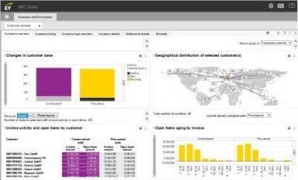
EY Helix
Our global suite of data and analytics
EY Helix, combined with our service approach that is connected, responsive and insightful, enables us to provide a higher–quality audit by:
Providing greater confidence in financial reporting as we identify hidden patterns and trends in your financial data and provide better business insights
Allowing us a deeper understanding of your business by analyzing larger populations of audit-relevant data to present a fuller picture
of activities and identify the risks that matter
Identifying trends and anomalies in your processes and controls
to help direct our investigative effort in the right areas
Providing relevant feedback and insights during the audit, so you
can optimize your business processes and controls
Saving your team valuable time and effort through our globally integrated data capture and extraction tools

Slide 36
Questions?
dunnc@gvsu.edu
Laura.Kline@ey.com

