Slide 1

AIS Bootcamp 2018
Distinguishing Independent Contractors from Employees: Analyzing
Company Practices and Compensation Data to Assess Compliance with IRS Factors
A. Faye Borthick, Professor, borthick@gsu.edu
Lucia N. Smeal, Clinical Assistant Professor, lnsmeal@gsu.edu
School of Accountancy

Slide 2
Presentation
Data analytics in tax practice
The issue: Employee versus independent contractor
The NewPub case
Voice over Access for first querying
Student results
Outcome of ATA submission
Invitation to use the case

Slide 3
Data analytics in tax practice
Maximize the present value of after-tax income/cash by:
  Analyzing data to foster compliance and avoid penalties
  Identifying opportunities for reducing taxes
  Allocating profits according to value creation
  Staying ahead of tax authorities, who can demand data in audits

Slide 4
NewPub case
The issue:
Risk of misclassifying workers as independent contractors (ICs) when they are really employees, resulting in deficiency assessments and penalties
Case staging:
Short conversation
Data from a fictitious accounting system: 5.6 MB in Access
Business process diagram (BPD)
Employee agreements
Reporting template with first two factors completed

Slide 5
Learning objectives
Perform tax research to identify the factors relevant to IRS’s classification of workers as employees or independent contractors.
Analyze agreements with workers and data from a client’s accounting system revealing its employment and payment practices to assess consistency with IRS’s factors.
Complete a memorandum to file that documents the findings from the analyses.

Slide 6
Case staging: Conversation
The scene: NewPub has asked its accounting firm to analyze its operations to determine if it is properly distinguishing between employee and contractor status for its writers. The CEO is Robert. The tax partner on the engagement is Rony. The senior tax professional is Jordan.
Robert | We have a large group of writers that gather and produce content for our Web site. We want to make sure the writers meet the requirements for being classified as independent contractors rather than employees. We have contracts with the writers, but some of the language is ambiguous. We don’t need any challenges from the IRS.
Rony | We’ll need access to data from your accounting system in the cloud. The IRS looks at numerous factors to make this determination, which means that we’ll need to evaluate such aspects as payroll, equipment purchases, benefits, travel, and other expenses.
Robert | Wow! I didn’t realize it was that multi-factored.
Rony | I’ll put one of our senior tax people, Jordan, on the project.
Jordan | For sure, Rev. Rul. 87-41 and Treas. Reg. § 31.3401(c)-1 apply. There may be court cases too. We’ll analyze your data based on that authority.
Notes:
Salient aspect: Staging the case with a short conversation, in the style of business communications. No multi-page narrative!

Slide 7
Authority
Rev. Rul. 87-41 (IRS 1987) (20 factors)
IRS. 1987. Employment status under section 530(d) of the Revenue Act of 1978: Internal Revenue Service. Rev. Rul. 87-41. C. B. 1987-1: 296.
Treas. Reg. § 31.3401(c)-1
Treasury, U.S. Department of the. 2015. Code of Federal Regulations, Employee, title 26 (2015): 223-224. Treas. Reg. § 31.3401(c)-1.

Slide 9
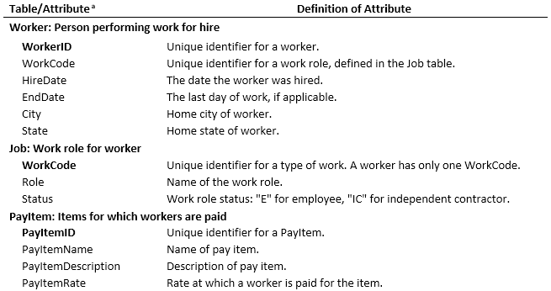
Data definitions: 1 of 2

Slide 10
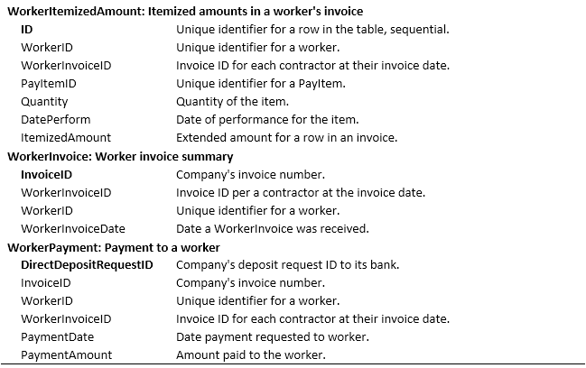
Data definitions: 2 of 2

Slide 11
Data: 5.6 MB Access file
Job table: 26 rows
PayItem table: 20 rows
Worker table: 117 rows
WorkerInvoice table: 2,992 rows
WorkerItemizedAmount table: 41,317 rows
WorkerPayment table: 3,000 rows

Slide 12
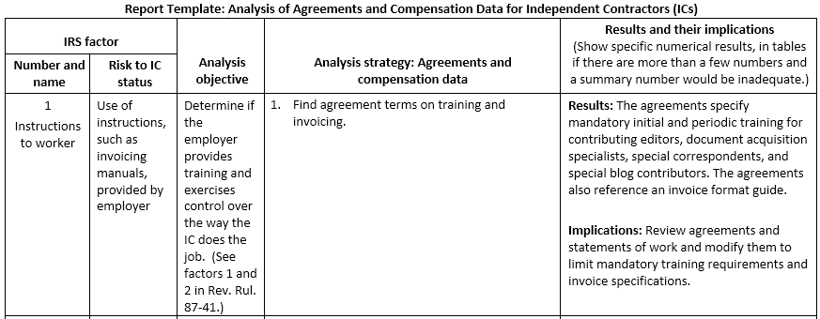

Slide 13
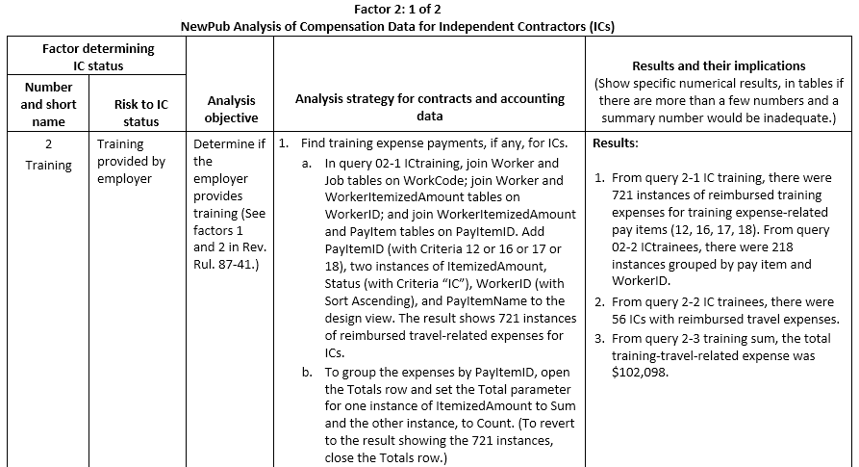

Slide 14
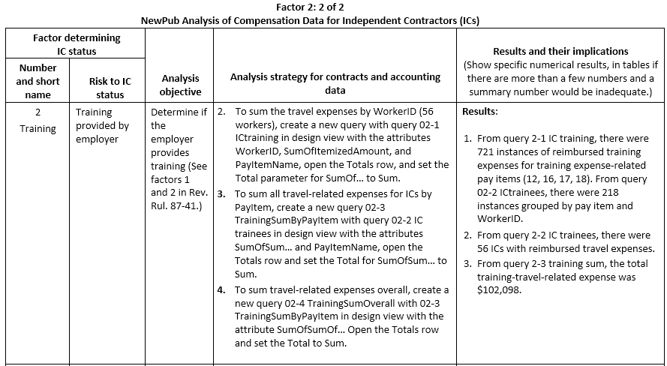

Slide 15
Querying tasks in Access
Join tables
Apply Group By
Set criteria on attributes

Slide 16
Why Microsoft Access?
Implements the relational database model, enabling a mental schema for using other relational query languages, e.g., SQL, ACL, IDEA, Hyperion, BusinessObjects
Widely available in student and professional environments
Shows the SQL it generates, the lingua franca of querying

Slide 17
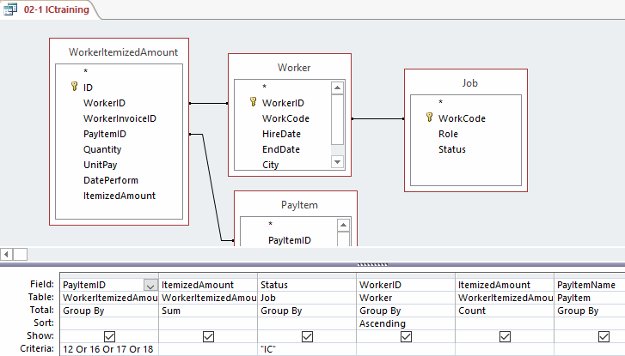
Query for factor 2: Training expenses
Notes:
For an explanation of the query, see the following two slides, which duplicate slides 8-9 (duplicated to avoid having to backtrack in the slide deck).
Explanation: To determine if ICs were paid for training:
Select PayItemID in PayItem = 12, 16, 17, or 18 (training codes).
Joined to WorkerItemizedAmount (what the worker submitted on an invoice).
Joined to Worker on WorkerID, joined to Job on WorkCode, where Status = “IC”.
Sum and count ItemizedAmount.

Slide 20
Voice over Access querying
Three 20-minute MP4 videos guiding viewers through querying for IRS Factor 2 Training provided to workers
Prepared as if viewers had no prior Access experience

Slide 21
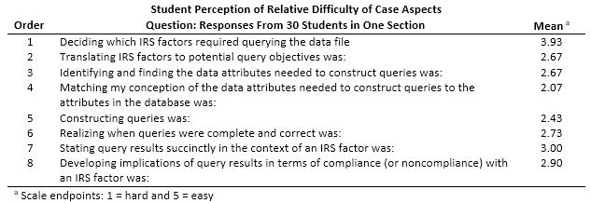

Slide 22
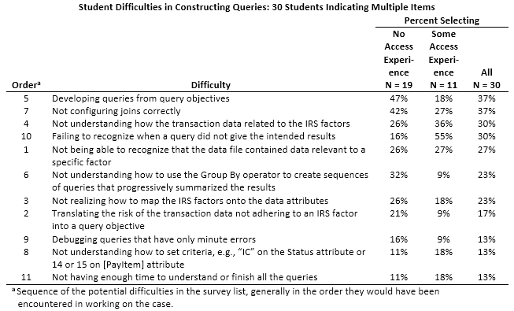

Slide 23
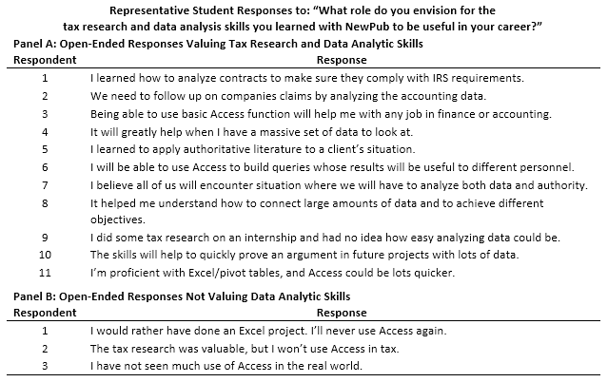
Notes:
Typical responses for many students’ first encounter with querying.

Slide 24
What does tax education need?
More data analytics in courses to
prepare students for professional tax practice!
For access to the case, contact:
Lucia N. Smeal, lnsmeal@gsu.edu

