Slide 1
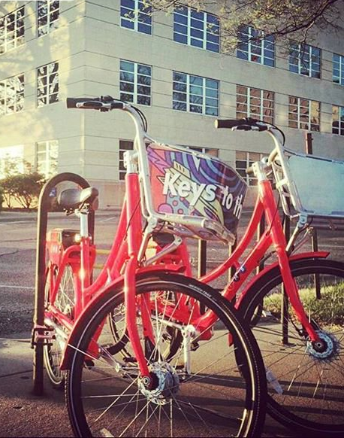
Analytics for Managerial Accounting
Metro Bike Share
Use Case For Excel
Case By:
Dr. Pamela J. Schmidt
Washburn University
User Experience:
Dr. Kimberly Swanson Church
University of Missouri Kansas City

Slide 2
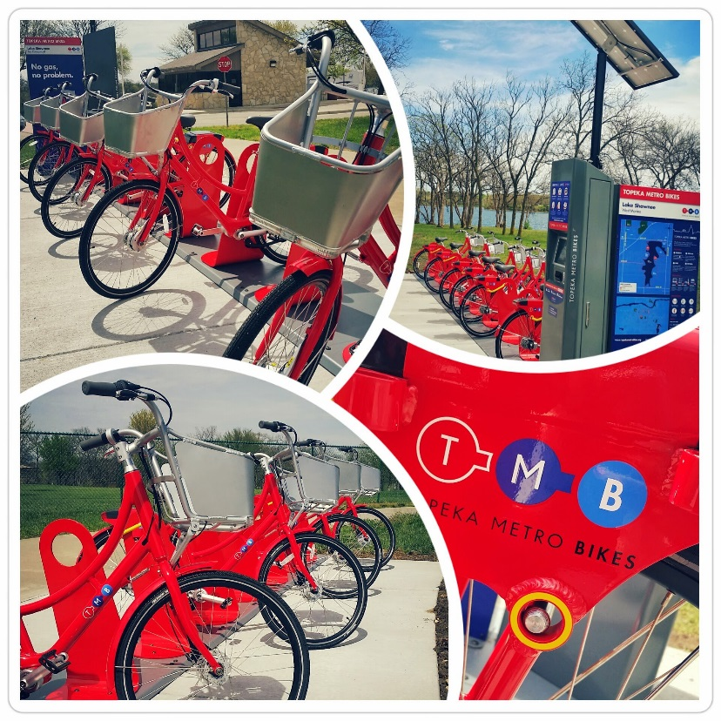
Managerial Accounting
Metro Bike Share - Use Case For Excel
Extract and Transform Bike Ride Data:
1 year of Metro Bike Ride data (seasonality)
Captured by Social Bicycles website, & Bike data
  Ride data: date/time, distance, duration
Notes:
https://topekametrobikes.org/
https://topekametro.org/get-your-annual-topeka-metro-bus-bike-pass-today/
https://www.visittopeka.com/things-to-do/outdoors/bikeshare/

Slide 3

Managerial Accounting
Metro Bike Share - Use Case For Excel
Extract and Transform Bike Ride Data:
1 year of Metro Bike Ride data (seasonality)
Captured by Social Bicycles website, & Bike data
  Ride data: date/time, distance, duration
  Transformations:
    Merged data sources (GeoLoc, “R”)
    Date/time formats (AM/PM)
  Descriptives: Ride Freq., Day of week,
    Popular bikes, …
Notes:
https://topekametrobikes.org/
https://topekametro.org/get-your-annual-topeka-metro-bus-bike-pass-today/
https://www.visittopeka.com/things-to-do/outdoors/bikeshare/

Slide 4
Managerial Accounting
Metro Bike Share - Use Case For Excel
Extract and Transform Bike Ride Data:
1 year of Metro Bike Ride data (seasonality)
Captured by Social Bicycles website, & Bike data
  Ride data: date/time, distance, duration
  Transformations:
    Merged data sources (GeoLoc, “R”)
    Date/time formats (AM/PM)
  Descriptives: Ride Freq, Day of week,
    Popular bikes, …
Goal: Build a bike cost model to support decision making on
  Maintenance costs
  Usage-Based Bike Valuation
Notes:
https://topekametrobikes.org/
https://topekametro.org/get-your-annual-topeka-metro-bus-bike-pass-today/
https://www.visittopeka.com/things-to-do/outdoors/bikeshare/

Slide 5
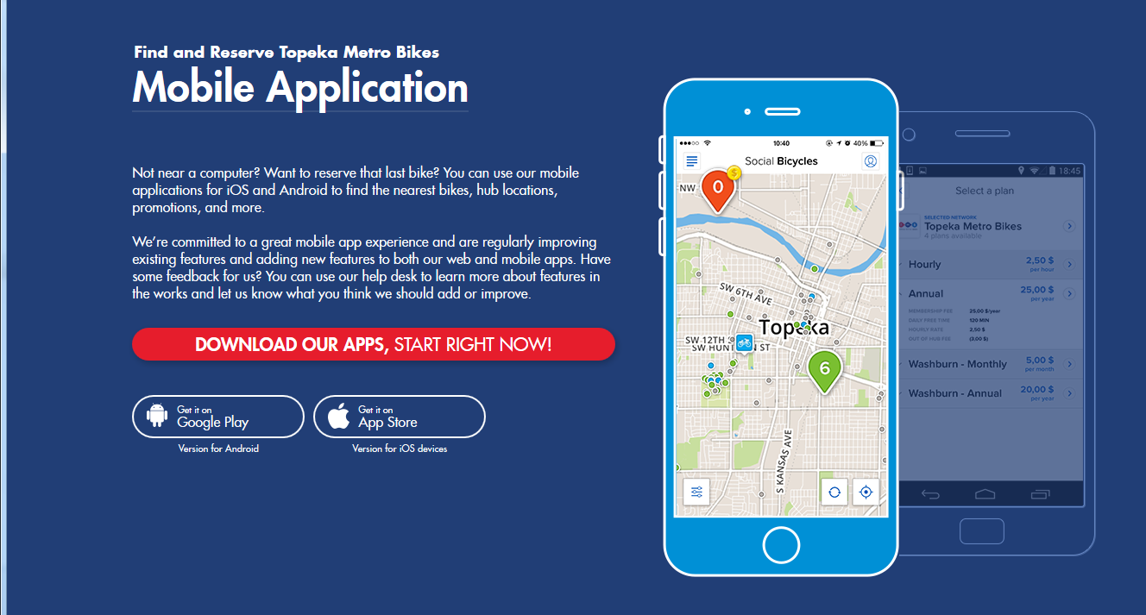
Topeka Metro Bike: Membership

Slide 6
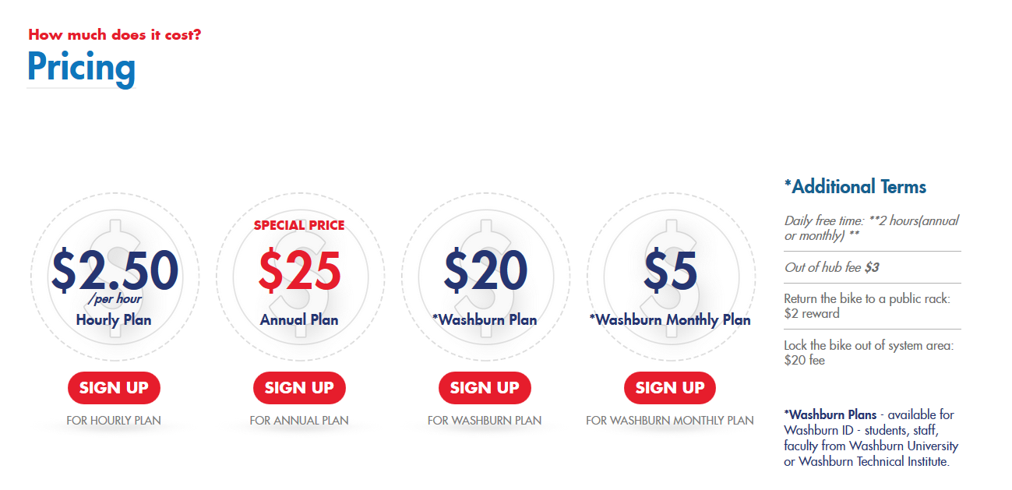
Member/User Costs: https://topekametrobikes.org/

Slide 7
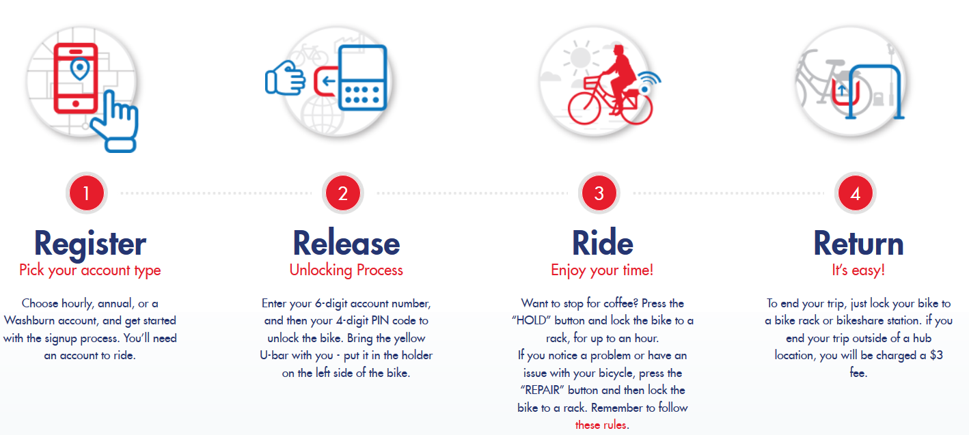
Topeka Metro Bike: Membership and Rides:
How it works

Slide 8
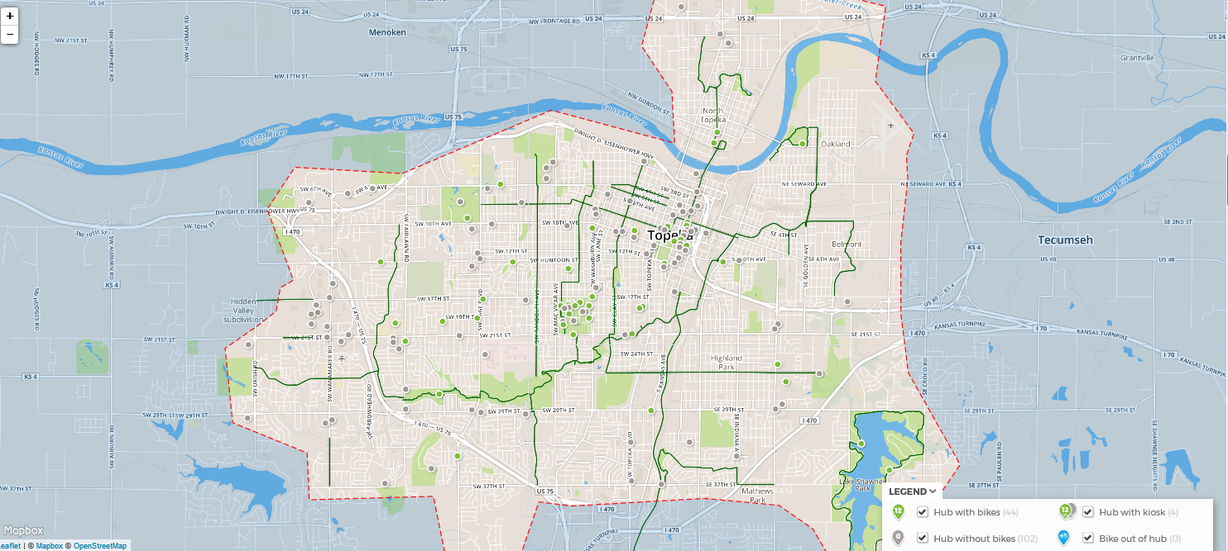
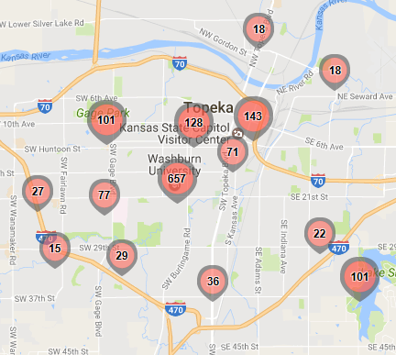
Topeka Metro Bike: Area Covered
Topeka Metro Bike: GPS (Global Positioning System) Data
Area Covered, hubs and live feed of bike locations

Slide 9
Create/Review Data Dictionary
Table | Field | Description | Type | Length | Notes
Trip Data | User ID | Unique identifier of each membership | Number | Double
Trip Data | Route ID | Unique identifier of each Ride's Route | Number | Double
Trip Data | Payment Plan | How each membership pay for the plan | Short Text | 255
Trip Data | Start Hub | What hub do each membership start | Short Text | 255
Trip Data | Start Area | No currently data | Short Text | 255
Trip Data | Start Latitude | The latitude where the trip start | Number | Double | Plan: Project using GPS data
Trip Data | Start Longitude | The longitude where the trip start | Number | Double | Plan: Project using GPS data
Trip Data | Start Date | The date when the trip start | Date/Time | m/d/yyyy
Trip Data | Start Time | The time when the trip start | Date/Time | m/d/yyyy | Plan: Transform by Splitting into separate columns: one for Date, one for time and one for AM/PM indicator; then transform date to determin Sun-Sat. 'Day of the Week', code for Week day, Week end
Trip Data | End Hub | What hub do each trip end | Short Text | 255
Trip Data | End Area | No currently data | Short Text | 255
Trip Data | End Latitude | The latitude where the trip end | Number | Double | Plan: Project using GPS data
Trip Data | End Longitude | The longitude where thetrip end | Number | Double | Plan: Project using GPS data
Trip Data | End Date | The date when the trip end | Date/Time | m/d/yyyy
Trip Data | End Time | The time when the trip end | Date/Time | m/d/yyyy | Plan: Transform into Date, time; then extract 'Day of the Week', code for Week day, Week end
Trip Data | Member Type | What type each membership is | Short Text | 255
Trip Data | Trip Conditions | No currently data | Short Text | 255
Trip Data | Trip Type | No currently data | Short Text | 255
Trip Data | Bike ID | * Bike ID Coding -Unique identifier of each bike | Number | Double | Plan: Code into: “Red” Bike Codes = 0, start with 686 and end with 4157."Blue” bike codes =1,those would start with 5398 and end with 8948.

Slide 10
Goal: Analyze TMB Business Data Set
To better support management’s business Decisions
Source Data Set: TMB Bike Rides for 1 year period
  As extracted from tracking website
  First: Understand available data (data dictionary)
  ETL: Extract, Transform and Load (60%-80% of work)
    collect data, translate formats and load into data store for analysis

Slide 11
Goal: Analyze TMB Business Data Set
To better support management’s business Decisions
Source Data Set: TMB Bike Rides for 1 year period
  As extracted from tracking website
  First: Understand available data (data dictionary)
  ETL: Extract, Transform and Load (60%-80% of work)
TMB Management’s Business Questions:
Which day of the week is more popular for Rides?
Average expected # rides on week day & on a weekend day?
Of 200 bikes (100 Red/original & 100 Blue/closed basket) which bikes are more popular (more rides: Red vs. Blue)?

Slide 12
Tips for Handling Large Excel worksheets
Know full size of data (total rows, and total columns) and use scroll bar effectively.
To select a full column of data:
  Input cell address in top/right menu bar to select last value. (Or scroll)
  Scroll up to view top value.
  Hold Shift-Key and click top value to get full column of values selected.
Quiz: what is max. number of rows in Excel 2016?
Quiz: does that number diminish if last rows are deleted?

Slide 13
Tips for Handling Large Excel worksheets
Know full size of data (total rows, and total columns) and use scroll effectively.
To select a full column of data:
  Input cell address in top/right menu bar to select last value. Or scroll.
  Scroll up to view top value.
  Hold Shift-Key and click top value to get full column of values selected.
Use of Home key (top/left value not to label)
Reformatting: what is visible and what is stored are NOT SAME
  Keep formulas for later correction/adjustment/extension
  For quick storing of actual numeric values, use Paste Special options.
Quiz: what is max. number of rows in Excel 2016?
Quiz: does that number diminish if last rows are deleted?

Slide 14
Tips for Handling Large Excel worksheets
Copy down (1,000’s of rows)
  Select top cell (top/left corner for block of cells)
  Scroll to bottom
  Then: hold SHIFT-Key, Click on bottom cell (or bottom/left corner for block)
Named Arrays (a great shortcut, safer than re-selecting cells)
  Select full array of cells (a meaningful grouping)
  Click inClick inside, type a name (no dash, space or special characters)
  to top/left text entry area (where current cell address usually displays)
Other Tips? Questions?
Quiz: Max. # of rows in Excel 2016? 1,048,576. (that is 2^20).
  In our TMB Data, today? 19,378 rows.
Quiz: does that number diminish if last rows are deleted? No.
Notes:
What is the maximum number of rows in Excel 2016?
Since Excel 2007 (Windows) and Excel 2008 (Mac), the number of rows in a .xlsx, .xlsm or .xlsb worksheet is fixed at 1,048,576. That is 2^20. Excel only stores the data and formatting actually used, so there is no penalty for having such a large number of rows in every worksheet.

Slide 15
Popular: Day of the Week? Time of Day?

Slide 16
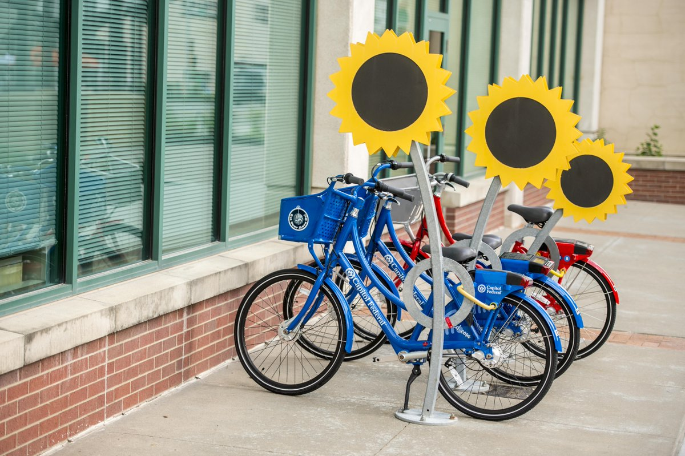
Popular Bike: Red versus Blue
TMB has two colors of bikes, red and blue.
Trips on blue bikes over the year totaled _______
Total trips taken on red bikes were _______
Indicate a bias towards ____ bikes
What are your conclusions?
Inspect and Consider:
  Availability of bikes at popular hubs
  Physical differences
  Visual condition

Slide 17
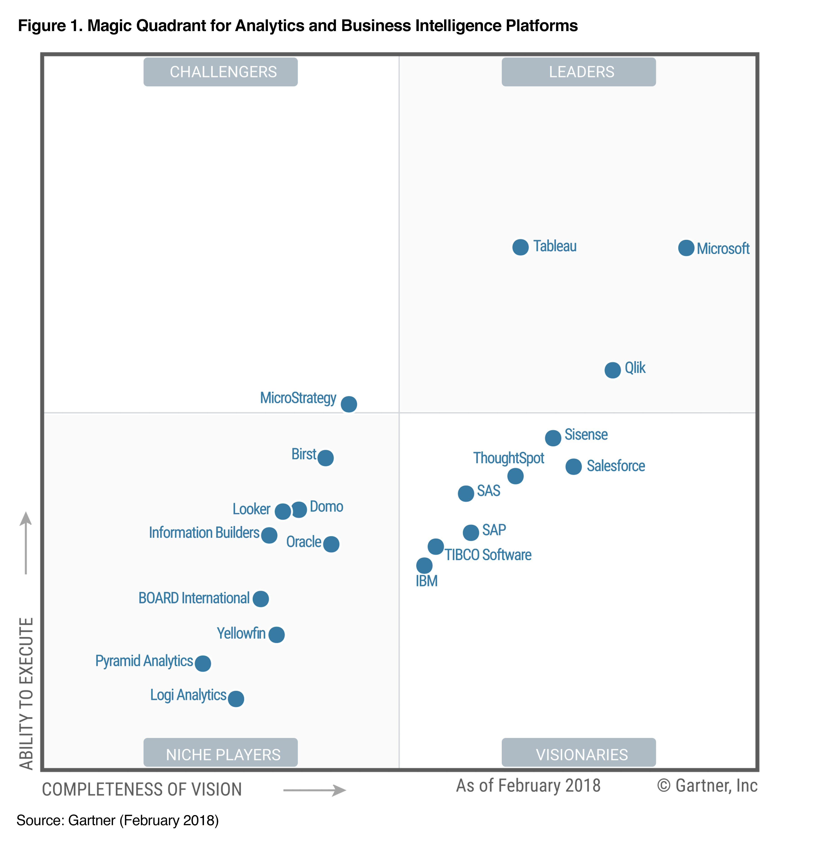
Insights from Data Visualization: Tableau

Slide 18
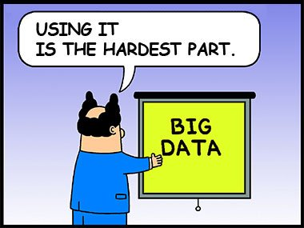
Audience Questions?
Notes:
Photos Courtesy of:
earth.google.com
twitter.com/topmetrobikes
www.facebook.com/topekametrobikes
www.facebook.com/topekaasianmarket/
jimsbikeblog.wordpress.com/2010/06/19/yikes-is-that-a-bike
http://cjonline.com/sites/default/files/14256511.jpg
http://aaahq.org/Meetings/2017/Midwest-Region/Program

