Slide 1
Cybersecurity in the Accounting Curriculum
Presented by
Diane Janvrin William L. Varner Professor / Associate Professor of Accounting
Steven Darroch Senior Manager, Cyber Risk | Deloitte

Slide 2
Overview
By the end of this session, you should be able to:
Discuss primary needs for cyber risk in the accounting curriculum
Discuss scenarios where cyber risk is relevant to accountants
Identify certain cyber elements that enhance accounting
Identify where to perform research and evaluate teaching tools for cyber risk

Slide 3
Cyber in Accounting Curriculum and Practice

Slide 4
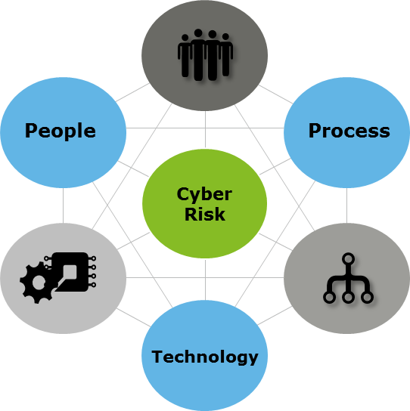
Synoptic view
Cyber Risk
Risk of loss, disruption or damage to the reputation of an organization due to failure or breach of information technology systems
Accountancy
Relevant, timely, and accurate information
Security & Privacy
Awareness and management of C.I.A. (Confidentiality, Integrity, and Availability) of Information

Slide 5
The unfolding of importance of cyber to accountants
Cybersecurity risk management attestation reporting framework - AICPA
Released April 24, 2017
AICPA Exposure Draft released re Description Criteria for SOC for Supply Chain
Released December 31, 2018
Securities and Exchange Commission (SEC) Disclosure Guidance
Released Oct 20, 2011
Cybersecurity National Action Plan (CNAP)
Released Feb 9, 2016
Presidential Executive Order on Cybersecurity
Released May 11, 2017
2011
Occupational
Outlook Handbook
>82,900 jobs in 14
>18% Growth
Avg. pay of $92k
2016
Online job searches * Indeed ™ >800 new jobs
Monster.com™ >700 jobs open
Forbes™ >1 million jobs in 2016
2017
2018
2019
* Not all-inclusive of online job websites
Presidential executive order: https://www.whitehouse.gov/the-press-office/2017/05/11/presidential-executive-order-strengthening-cybersecurity-federal
CNAP: https://obamawhitehouse.archives.gov/the-press-office/2016/02/09/fact-sheet-cybersecurity-national-action-plan
SEC Disclosure: https://www.sec.gov/divisions/corpfin/guidance/cfguidance-topic2.htm
DHS Critical Infrastructure: https://www.dhs.gov/critical-infrastructure-sectors
Occupational Outlook: https://www.bls.gov/ooh/computer-and-information-technology/information-security-analysts.htm
Cybersecurity risk management attestation reporting framework: https://www.aicpa.org/InterestAreas/FRC/AssuranceAdvisoryServices/Pages/AICPACybersecurityInitiative.aspx
Exposure Draft – Supply Chain SOC: https://www.aicpa.org/content/dam/aicpa/interestareas/frc/assuranceadvisoryservices/downloadabledocuments/exposuredrafts/ed-description-criteria-for-vsc.pdf

Slide 6
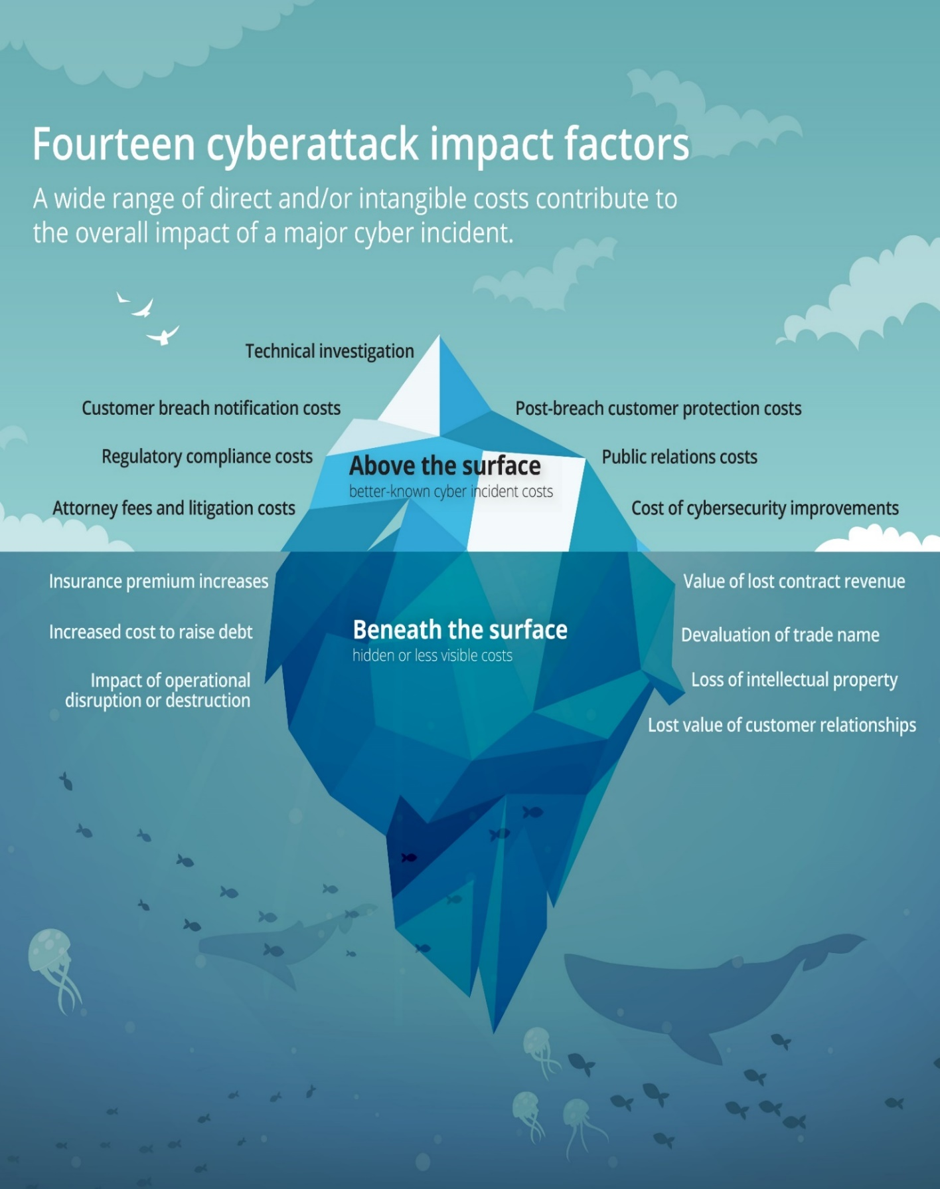
Real business impact
Impact factors that affect an organization in the days, months, and years following a cyberattack—there’s much more beneath the surface.
Costs associated with typical data breaches may only be the tip of the iceberg
Triage is costly, but the long term impacts can be costlier
Deloitte: Beneath the surface of a cyberattack: https://www2.deloitte.com/us/en/pages/risk/articles/hidden-business-impact-of-cyberattack.html

Slide 7
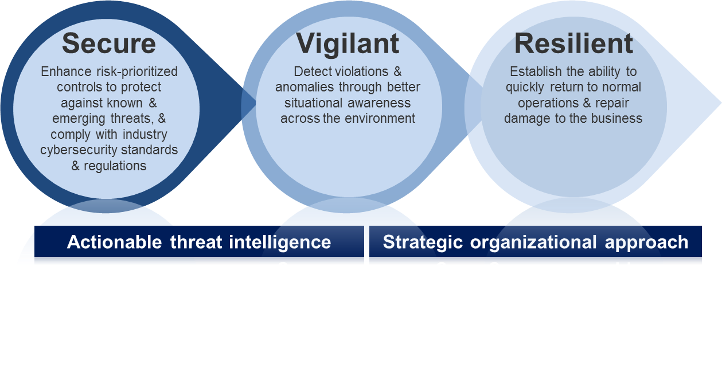
Deloitte’s Cyber Risk Evolution
Starting with key cyber security areas, built on industry leading practices and regulatory expectations.
Inputs
Deloitte’s Cyber Risk Framework
Industry standards
ISO¹ 27001/2
NIST² cybersecurity framework
Global privacy and data protection laws
ITIL³
AICPA Trust Services Criteria
Leading practices
Business Objectives
Growth/ Innovation
Operational Efficiency
Brand Protection
Risk-Based Decision Making
Compliance
Information security
Risk management
Project/program management
Published industry research
Governance and Oversight
The organizational structure, committees, and roles & responsibilities for managing information security
Policies and
Standards
Expectations for the management of information security
Management Processes
Processes to manage risks in information security risk management and oversight
Tools and
Technology
Tools and technology that support the risk management lifecycle and integration of risk with cyber risk domains
Risk Metrics and Dashboard
Reports identifying risks and performance across information security domains; communicated to multiple levels of management
Secure
Vigilant
Operating Model Components
Resilient
Threat Landscape
Who might attack?
What are they after?
What tactics will they use?
1. Risk & compliance management
5. App Security & Secure SDLC⁵
9. Vulnerability Management
12. Cybersecurity Operations
15. Crisis Management
Cyber Risk Domains
2. Identity & Access Management
6. Asset Management
10. Threat Intelligence
13. Predictive Cyber Analytics
16. Resiliency & Recovery
3. Data Protection & Management
7. Third-Party Risk Management
11. Security and Threat Monitoring
14. Insider Threat Monitoring
17. Cyber Simulations
¹ International Organization for Standardization
² National Institute for Standards and Technology
³ Formerly known as the Information Technology Infrastructure Library
4. Infrastructure Security
8. Physical Security
18. Incident Response & Forensics
Business Security
Secure Client Service Delivery

Slide 8
Deloitte’s Cyber Risk portfolio
End-to-end cybersecurity
Cyber Strategy
Secure
Vigilant
Resilient
We help executives develop a cyber risk program in line with the strategic objectives and risk appetite of the organization.
We focus on establishing effective controls around the organization’s most sensitive assets and balancing the need to reduce risk, while enabling productivity, business growth and cost optimization objectives.
We integrate threat data, IT data and business data to equip security teams with context-rich intelligence to proactively detect and manage cyber threats and respond more effectively to cyber incidents.
We combine proven proactive and reactive incident management processes and technologies to rapidly adapt and respond to cyber disruptions whether from internal or external forces.
Cyber Strategy, Transformation and Assessments
Cyber Risk Management and Compliance
Cyber Training, Education and Awareness
Infrastructure Protection
Vulnerability Management
Application Protection
Identity and Access Management
Information Privacy and Protection
Advanced Threat Readiness and Preparation
Cyber Risk Analytics
Security Operations Center
Threat Intelligence and Analysis
Cyber Incident Response
Cyber Wargaming

Slide 9
Cyber Risk Elements for Accounting Savvy

Slide 10
Measuring without a common yardstick can cause confusion
Business leaders’ responsibilities drive affinities for frameworks. A common language for cybersecurity risk management reporting helps organizations more effectively evaluate their cyber programs and facilitates consistent, transparent communication across the enterprise and to external stakeholders.
CxOs
Board
COBIT
ISO 27001
NIST CSF
HITRUST
SANS Top 20
CIO
CAE
Trust Services Criteria
CISO
Acronyms defined
COBIT—Control Objectives for Information and Related Technologies
HITRUST – Health Information Trust Alliance
ISO—International Organization for Standardization
NIST CSF—National Institute of Standards and Technology Cybersecurity Framework
SANS - SysAdmin, Audit, Network and Security

Slide 11
NIST Common Security Controls Framework
Framework for Improving Critical Infrastructure Cybersecurity Version April 16, 2018
NIST Cybersecurity Framework
1 - Identify
2 - Protect
3 - Detect
4 - Respond
5 - Recover
Develop the organizational understanding to manage cybersecurity risk to systems, assets, data, and capabilities.
Develop and implement the appropriate safeguards to ensure delivery of critical infrastructure services.
Develop and implement appropriate activities to identify the occurrence of a cybersecurity event.
Develop and implement the appropriate activities to take action regarding a detected cybersecurity event.
Develop and implement activities to maintain plans for resilience and to restore any capabilities and services impaired due to a cyber event.
1 - Identify
2 - Protect
3 - Detect
4 - Respond
5 - Recover
1.1 Asset Management
2.1 Access Control
3.1 Anomalies and
Events
4.1 Response Planning
5.1 Recovery Planning
1.2 Business Environment
2.2 Awareness and Training
3.2 Security Continuous Monitoring
4.2 Communications
5.2 Improvements
1.3 Governance
2.3 Data Security
3.3 Detection
Processes
4.3 Analysis
5.3 Communications
1.4 Risk Assessment
2.4 Information Protection
4.4 Mitigation
1.5 Risk Management
2.5 Maintenance
4.5 Improvements
1.6 Supply Chain Risk Management
2.6 Protective Technology
https://www.nist.gov/cyberframework

Slide 12
ISO/IEC 27001/2
Information Security Management System (ISMS) published by International Organization for Standards, 2013
The PDCA Cycle
ISO 27001 DOMAINS:
1. Security policy
2. Organization of information security
3. Asset management
4. Human resources security
5. Physical and environmental security
6. Communications and operations management
7. Access control
8. Information systems acquisition, development and maintenance
9. Information security incident management
10. Business continuity management
11. Compliance
Act
Plan
Do
Check
Corrective & Preventative Action
Monitor &
Review
Risk & Requirements
Implement
& Operate
Inputs
(Incl. Business
Requirements)
Outputs
(Incl. Reporting
Business Value)
https://www.iso.org/standard/54534.html

Slide 13
AICPA’s cybersecurity attestation reporting framework
On April 24, 2017, the AICPA released its cybersecurity attestation reporting framework (SOC for Cybersecurity), which is intended to expand cyber risk reporting to address the marketplace need for uniformity and greater stakeholder transparency.
Key Stakeholders
AICPA Cybersecurity Attestation Reporting Framework
Benefits
(1) Greater transparency;
(2) Independent and objective reporting;
(3) Operational efficiencies;
(4) Useful in making informed & strategic decisions;
(5) Strategic competitive advantage and enhancement to brand and reputation; and
(6) A comprehensive set of criteria/control framework(s).
Board of Directors
1
Management’s description of the cybersecurity risk management program
Regulators
2
Management’s assertion on:
The presentation of the description
The operating effectiveness of the controls to achieve the cybersecurity objectives
Cyber Insurance Carriers
Practitioner's opinion on:
The presentation of the description
The operating effectiveness of the controls to achieve the cybersecurity objectives
3
Customers
Flexible criteria
Source: Description Criteria for Management’s Description of an Entity’s Cybersecurity Risk Management Program https://www.aicpa.org/InterestAreas/FRC/AssuranceAdvisoryServices/Pages/AICPACybersecurityInitiative.aspx

Slide 14
Cyber in Accounting Curriculum and Practice

Slide 15
At issue: primary types of accounting student audience
Traditional
External Auditors
Internal Auditors
Management Accountants
Consulting
Cyber Risk
Information Assurance
Compliance

Slide 16
At issue continued: potential courses and options
Several Potential Courses
Introduction to Accounting Information Systems / Introduction to Data Analytics (frameworks and data analytics mindset and skills)
Introduction to Auditing (Professional skepticism for cyber and risk assessment process and approaches)
IT Auditing (Control assessment, control development, control testing, project management)
Incorporate concepts in multiple courses
For cybersecurity specialists, potentially offer multiple courses
Our approach – based upon skills needed
Open brainstorming on where cyber concepts should be taught

Slide 17
Information Assurance Syllabus Survey
Topic area covered | Number of syllabi listing topic
General topic discussion | 30
Access control (technical) | 5
Telecommunications and network security (technical) | 7
Software development security (technical) | 4
Cryptography (technical) | 7
Security architecture and design (technical) | 3
Operations security (technical) | 2
Physical (environmental) security (technical) | 2
Information security governance and risk management (non-technical) | 7
Information security program development and management (non-technical) | 1
Information security incident management (including business continuity and disaster recovery planning) (non-technical) | 5
Legal, regulations, investigations, and compliance(non-technical) | 5
Other topics (including computer forensics, privacy, intellectual property) | 13

Slide 18
Developing Cybersecurity Specialist Programs
Cybersecurity Curricula recommended by multiple bodies
Association for Computing Machinery (ACM)
IEEE Computer Society (IEEE-CS)
Association for Information Systems Special Interest Group on Information Security and Privacy (AIS SIGSEC)
International Federation for Information Processing Technical Committee on Information Security Education (IFIP WG 11.8)
National Institute for Standards and Technology (NIST) NICE Framework

Slide 19
Structure of the cybersecurity discipline
Risk Mgmt.
Policy
Ethics
Human Factors
Cybersecurity
(A computing-based, interdisciplinary course of study)
Law
Interdisciplinary Content
Computer Science
Computer Engineering
Information Technology
Information Systems
Software
Engineering
Computing
Disciplining
Source: ACM Cybersecurity Curriculum: https://www.acm.org/binaries/content/assets/education/curricula-recommendations/csec2017.pdf

Slide 20
Characteristics of a Cybersecurity Program
Each graduate of a cybersecurity program of study should have a cybersecurity curriculum that includes:
A computing-based foundation (e.g., computer science, information technology),
Crosscutting concepts that are broadly applicable across the range of cybersecurity specializations (e.g., cybersecurity’s inherent adversarial mindset),
A body of knowledge containing essential cybersecurity knowledge and skills,
A direct relationship to the range of specializations meeting the in-demand workforce domains
A strong emphasis on the ethical conduct and professional responsibilities associated with the field.

Slide 21
CSEC thought model
The thought model includes the following six crosscutting concepts:
Confidentiality. Rules that limit access to system data and information to authorized persons.
Integrity. Assurance that the data and information are accurate and trustworthy.
Availability. The data, information, and system are accessible.
Risk. Potential for gain or loss.
Adversarial Thinking. A thinking process that considers the potential actions of the opposing force working against the desired result.
Systems Thinking. A thinking process that considers the interplay between social and technical constraints to enable assured operations.
Source: ACM Cybersecurity Curriculum: https://www.acm.org/binaries/content/assets/education/curricula-recommendations/csec2017.pdf

Slide 22
Additional Resources

Slide 23
Further sources of information…
AICPA (American Institute of CPAs) https://aicpa.org
ISO 27001 (International Organization for Standardization) https://www.iso.org/home.html
NIST (National Institute of Standards and Technology; NIST Common Security Framework) https://www.nist.gov/; https://www.nist.gov/cyberframework
ISACA (Information Systems and Controls Association) https://www.isaca.org/pages/default.aspx
SANS (Systems Administration Networking and Security Institute) https://www.sans.org/
ISC2 (International Information Systems Security Certification Consortium) https://www.isc2.org/
ISF (Information Security Forum) https://www.securityforum.org/
Gartner (External research and analysis) http://www.gartner.com/technology/home.jsp
NIST National Initiative for Cyber Education (NICE): https://www.nist.gov/itl/applied-cybersecurity/nice
The Cyber Education Project: https://cybereducationproject.org
Deloitte: Beneath the surface of a cyberattack: https://www2.deloitte.com/us/en/pages/risk/articles/hidden-business-impact-of-cyberattack.html
Association for Computing Machinery, Curriculum Guidelines for Post-Secondary Degree Programs in Cybersecurity: https://www.acm.org/binaries/content/assets/education/curricula-recommendations/csec2017.pdf
Cybersecurity Curricula 2017 Curriculum Guidelines for Post-Secondary Degree Programs in Cybersecurity ASM, IEEE-CS, AIS SIGSEC, IFIP WG 11.8. Available at: https://www.acm.org/binaries/content/assets/education/curricula-recommendations/csec2017.pdf
Cram, W.A., and J. D’Arcy. 2016. Teaching information security in business schools: Current practices and a proposed direction for the future. Communications of the Association of Information Systems 39 (3): 32-51.

Slide 24
Questions?

