Slide 1
Presidents Quarterly Roundtable
November 17, 2025

Slide 2
Agenda
Membership
Finance/HR
Governance Update – Board Slate
Board & Council Updates
Changes Underway for Reimagining the August Meeting
General Membership Updates
International Membership Updates
Pilot and New Membership Categories Updates
Meetings
Center for Advancing Accounting Education
Publications
Open Access
IT/Membership/Marketing
Foundation

Slide 3
Membership - Update
BILL PERIOD | Selected Date | Membership Counts
2025/26 | AS OF 11-5-2025 | 5079*
2024/25 | AS OF 11-5-2024 | 5046
2024/25 | EOMY | 5827
2023/24 | EOMY | 6179
2022/23 | EOMY | 6273
2021/22 | EOMY | 6599
* Membership opened 2 weeks later in 2025 vs. 2024

Slide 4
Section Membership - Update
BILL PERIOD | Selected Date | Membership Counts
2025/26 | AS OF 11-5-2025 | 6459*
2024/25 | AS OF 11-5-2024 | 6440
2024/25 | EOMY | 7212
2023/24 | EOMY | 7821
2022/23 | EOMY | 8249
2021/22 | EOMY | 8643
* Membership opened 2 weeks later in 2025 vs. 2024

Slide 5
Finance/HR Update
Finance
Wolf & Co has now taken over AR in addition to AP and financial reporting
Audit is complete
HR
Dismissed two employees in October
Hired one employee in November
Current Staffing:
20 Full-time Employees
2 Part-time consultants
2 part-time employees
1 Intern

Slide 6
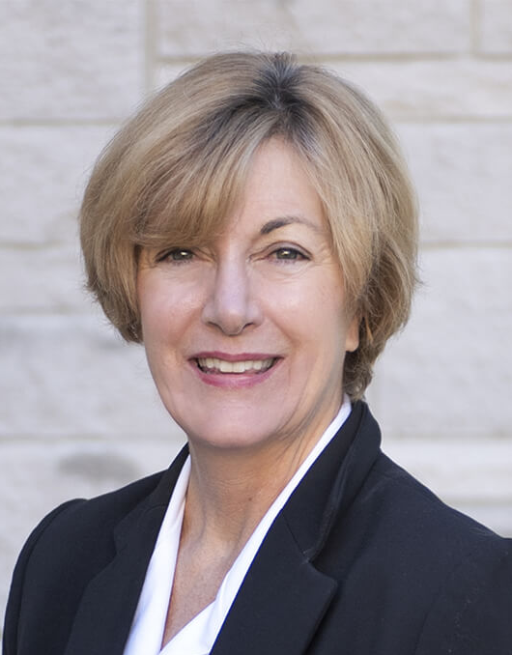
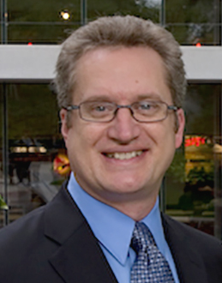
Nominees for President-Elect
Leslie D. Hodder Indiana University-Bloomington
Timothy J. Rupert
Northeastern University

Slide 7
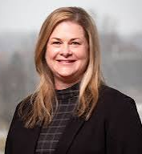
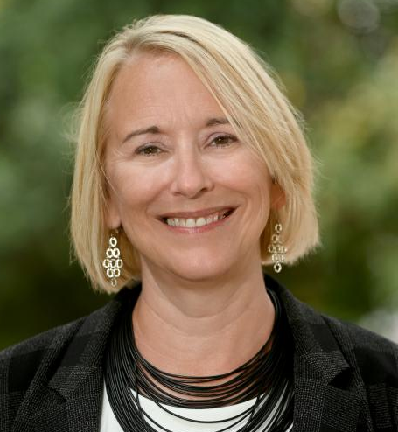
Nominees for Vice President-Education
Kimberly S. Church Missouri State University
Rebecca Shortridge
The University of Tennessee - Chattanooga

Slide 8
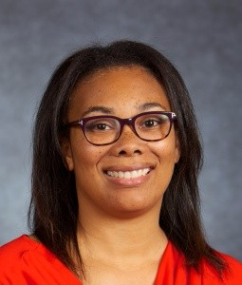
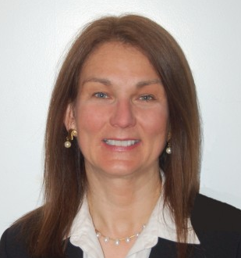
Nominees for Director-Focusing on International
Stephani A. Mason
DePaul University
Elizabeth Gordon
Temple University

Slide 9
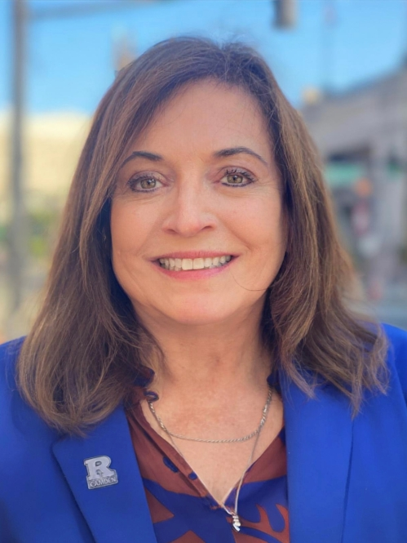
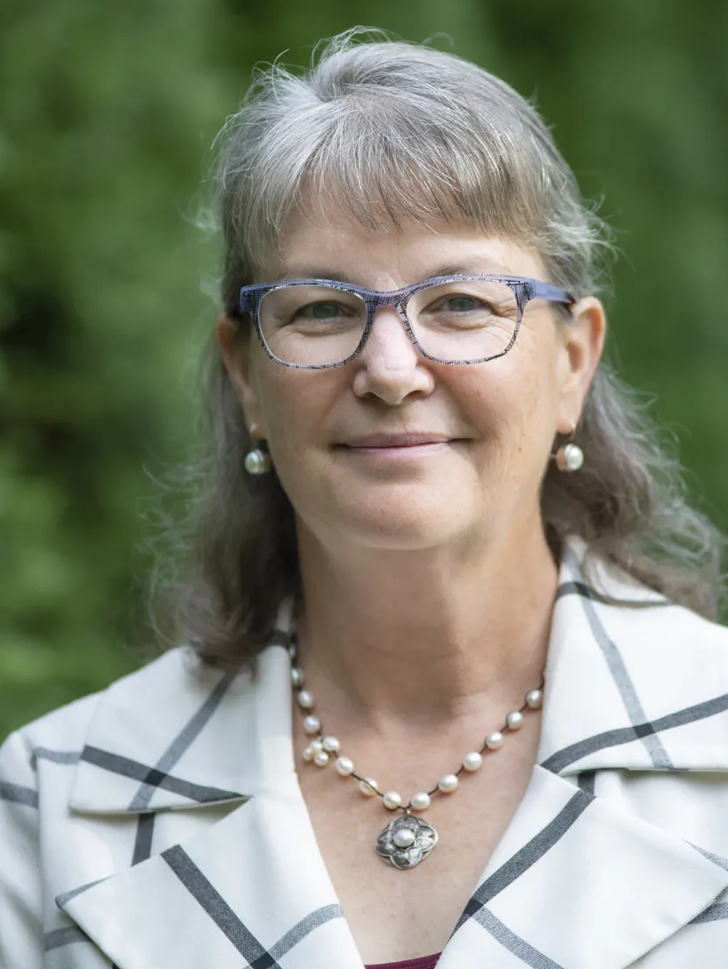
Nominees for Director-Focusing on Membership
Sandra B. Richtermeyer
Rutgers, The State University of
New Jersey-Camden
Margaret B. Shackell
Ithaca College

Slide 10
2026 Board of Directors Election Timeline
The exact dates are dependent on the day the Slate is Posted.
September 10: Nominations Committee met and selected candidates for President-Elect,
VP Education, and Director-Focusing on International
November 8: Council Ballot Committee met to choose two candidates for Director-Focusing on Membership
Mid-end November: Slate was posted on November 13 and announced to membership
December: Get to Know the Candidates webpage is posted online and announced to membership
Early 2026: Ballot opens for online voting and announced to membership. The ballot is open for at least 30 days.
After Ballot closes and is verified: New Officers announced to membership and posted online

Slide 11
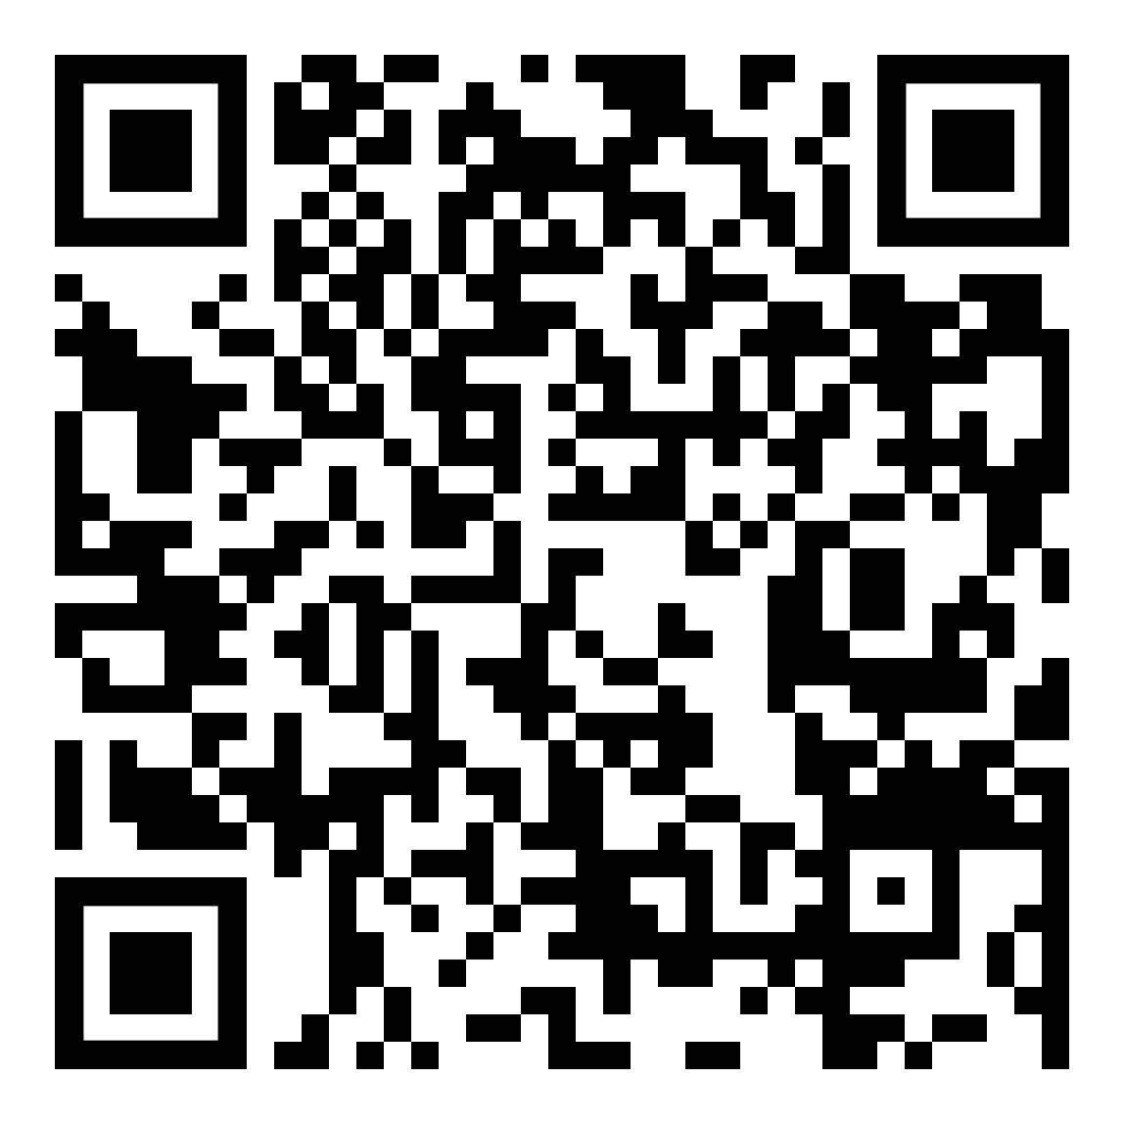
AAA Bylaws Revisions Vote
Why do these updates matter? The proposed updates:
Replace outdated wording from 2022,
Clarify Board of Directors and Council responsibilities, and
Realign Member responsibilities with current AAA processes
Vote Today!

Slide 12
Board Meeting Update
Accepted the Audited Financials – Business Meeting on 11/11/2025
Approved Publications Policies
Voted on OA Article Processing Charges (APCs) for the three AAA-wide Journals
Approved the TAR Editor Slate for Mohan
Changed Board Liaison for AHOF Committee
Discussed August Meeting speakers
Discussed Public Relations for AAA
Approved AAA Populating a Task Force to Reimagine the August Meeting

Slide 13
Council Meeting Update
CBC Populated Ballot for Director Focusing on Membership
Council Began Voting for CCAC Members
Discussed “Reimagining the August Meeting”
Discussed International Membership Access and Engagement Options

Slide 14
August Meeting Decisions Already In Process
Move DATA (formerly IDA) to the August Meeting Timeframe
Steering Committee Continues
Proposed Training Day on Sunday – Separate Fee
Proposed Track in Regular Meeting
Move ESG/Sustainability to the August Meeting as a Track
Steering Committee Continues
Include a TAR Track for Early-Stage Research at the Annual Meeting (Tuesday afternoon and Wednesday)
Kick-Off at Tuesday Lunch with TAR Historical Review by Mohan
Not a submission to TAR
Paper Submission Fee - $100
Create a Dedicated Networking Space for Sections
Lighten Monday Night Reception Food and Add Lunches on Monday and Tuesday (included in registration fee)
Bring Back a Revamped Host Program
Possible Name: AAA Global Connect

Slide 15
General Membership Outreach Updates
Surveys and Focus Groups
2x/year across General Membership, PhD Students, Practitioner, Retired groups
Communications
Email and Social Media campaigns - ongoing
Membership Advisory Committee (MAC)
AAA Membership Value & Engagement Survey (championed by IMAC)
Targeted Advertising
Google Grants and Google Paid ads
PropFuel (Micro polls)
Targeted engagement of non-Section membership
Renewing / Lapsed Members
Annual Meeting “Reimagining” feedback

Slide 16
International Engagement
Focus Groups at AAA-AM
Barriers, themes, recommendations
International Membership Advisory Committee (IMAC)
Grassroot member-driven initiative
IMAC pre-work survey
IMAC recommendations:
Research & publishing support
Teaching & pedagogy
Outreach & membership engagement
Championing the AAA Membership Value & Engagement Survey
Collecting ideas for enhancement of international members experiences at the the AAA Annual Meeting & Spark Virtual Conference

Slide 17
International Engagement
AAA Membership Value & Engagement Survey
Participation, AAA value, barriers and recommendations
AAA-IMA Partnership (MENA)
Cairo Academic Summit in Egypt (November 2025)
Professional and Academic Roundtable in Dubai, UAE (January 2026)
Finance Excellence & Leadership Summit in Dubai, UAE (May 2026)
University/Conference Meetings – MENA Region
AUC and Cairo University visits, Egypt (November 2025)
Accounting, Governance & Sustainability (AGS) Conference hosted by KFUPM, KSA (December 2025)
World Continuous Audit & Reporting Symposium hosted by American University of Sharjah, UAE (December 2025)

Slide 18
Departmental Pilot

Slide 19
Practitioner Pilot
CalCPA and ICPAS have continued to promote the discounted pilot
CalCPA started sending to the correct audience after initial missteps
~16k members targeted in emails
ICPAS – initially more responsive, now less enthusiastic
Both organizations have narrowed the reach of the emails after initial outreach had low reception

Slide 20
Tiered Membership – November 1

Slide 21
Meetings Update
Annual Meeting
Submissions are open for AM 2026!
New track this year – The Accounting Review Early-Stage Research Track
Visit the AM webpage to see information on the hotel, partners, and Las Vegas
Midyear Meetings
Six out of Eleven Meetings this year will take place at universities/conference centers.
Expectation is this will continue as future year site selections are underway.
Meetings Model Committee
New committee chair-elect is Vern Richardson who will lead the committee starting in fall of 2026
The committee will meet next week. Any updates from the committee can be found on the Segment Leader Website.

Slide 22
Center Update
Pipeline Update
Update on FASO Working Groups
Principles Bootcamps / Information Sessions (held with 8 State Societies)
Panels at TACTYC, CTLA, Annual Meeting, EAC/TLC Midyear (May-October)
CPE
Asynchronous (including 30.2 CPE hours from Annual Meeting)
COSO
Webinars
Exchange Podcast
Booking weARE and Pipeline Webinars into late Spring 2026
Future Plans
Identify additional Practitioner Subject Experts (Webinars, Meetings, Podcasts, etc.)
Identify Hot Topics for future Webinars

Slide 23
Publications Update
Backfile
Signed contract with Aptara, which is now preparing TAR articles from 1926-1998 to be added to Digital Library by the end of the year; backfiles for seven other journals will be processed after that.
Accessibility
Now requiring authors to include “alt-text” describing all article images to comply with European Accessibility Act and U.S. ADA
ResearchGate
New “Journal Home” pages give platform users more information about the journals and AAA
Will provide metrics of who is viewing our content and provide opportunities to connect directly with potential authors
AVRIS Technologies (INSEAD)
Turing 5 teaching cases into a VR educational experience

Slide 24
What is Hybrid Open Access Publishing?
Open access: published articles are permanently and freely available for anyone to read.
Hybrid: authors choose whether to publish OA or under the traditional subscription model when their articles are accepted for publication.
Gold: authors pay an Article Publication Charge which allows them to retain the copyright and make articles freely available for reading, downloading, and sharing.

Slide 25
Common questions
Why is AAA making this OA option available? Competitor journals publish an average 33% of their articles as Open Access. Some authors must publish OA due to school or funder requirements
What are the benefits of publishing OA? OA articles have more impact because they have more views, more cites, and higher Altmetric statistics.
What are the costs associated with publishing my article OA? Authors will pay an Article Publication Charge (APC) that varies by journal.
Is this predatory (e.g., pay to publish)? No, the submission and peer review process will be conducted as normal and the author decides after article’s final acceptance whether to publish it OA.
Notes:
A 2025 Wiley whitepaper reports that its hybrid OA articles were viewed 4.2 times the level of subscription articles and were cited 1.5 times more.

Slide 26
OA Article Publication Charges
Benchmarked with peer journals
Association journal APCs:
TAR $3900
AH $3400
IAE $3400

Slide 27
Next steps: Sections must make OA decision
To decide:
Should your section’s journal offer OA option?
What APC should the journal charge?
When would you begin?
How will you educate your members?

Slide 28
Next steps: Sections must make OA decision
Webinar December 1, 2-3pm ET for section leaders
Webinar topics:
What is hybrid OA publishing?
What decisions do sections need to make (offer the option, set an APC)?
What are APCs at comparable journals?
How will this affect section finances?

Slide 29
IT /Membership / Marketing Update
Tiered and New Membership Categories Launched
New / Updated Websites / Features
Async Annual Meeting videos launched
Beta testing of LMS Content Repository intake
Dynamic language translation of websites
Beta testing personalized event / calendar / tool
PropFuel Platform integrated
Micropolls and short-form engagement
Membership and Conference focus
Section Engagement
Annual Meeting Survey
Migrations / Upgrades
Protech Improvements
AR Outsourcing

Slide 30
Foundation Activities
Two-Year Bridge Symposium
Held on November 14th
Received 1,810 Applications, Anticipate Nearly 1,100 Participants
Accounting Hall of Fame
Nomination Applications Closed on October 31st for 2026
Development of Teaching Resources from 2025 Awardee Videos
High School Accounting Course
Survey in Accounting; Technology Enabled
Partnering with NBEA and Others
Conducting Interviews with High School Teachers

Slide 31
Questions?

