Slide 1
Presidents Quarterly Roundtable
February 25, 2026

Slide 2
Agenda
Membership Numbers
Governance
Finance/HR
Meetings
Center for Advancing Accounting Education
Publications
IT/Membership/Marketing
International Membership Updates
Foundation
Segments Action Items

Slide 3
Membership - Update
BILL PERIOD | Selected Date | Membership Counts
2025/26 | AS OF 11-5-2025 | 5079*
2024/25 | AS OF 11-5-2024 | 5046
2024/25 | EOMY | 5827
2023/24 | EOMY | 6179
2022/23 | EOMY | 6273
2021/22 | EOMY | 6599
* Membership opened 2 weeks later in 2025 vs. 2024

Slide 4
Section Membership - Update
BILL PERIOD | Selected Date | Membership Counts
2025/26 | AS OF 11-5-2025 | 6459*
2024/25 | AS OF 11-5-2024 | 6440
2024/25 | EOMY | 7212
2023/24 | EOMY | 7821
2022/23 | EOMY | 8249
2021/22 | EOMY | 8643
* Membership opened 2 weeks later in 2025 vs. 2024

Slide 5
Governance Updates
Board of Directors Election
  Election closed Monday, February 23
  Results have been certified by AAA Auditors
  Candidates will be notified of outcome
  New Board announced to Membership
Call for Nominations for AAA Nominations Committee
  Open through Friday, February 27
Upcoming Virtual Board and Council Meetings
  Board: Wednesday, March 4
  Council: Tuesday, March 24
  Board: Thursday, April 2

Slide 6
Finance/HR Update
Finance
  Working on Budget
  Finance Committee met 2/24 and approved first draft
  Wolf is close to having financials ready by EOM after quarter close

Slide 7
Meetings Update
Global Connect (formerly Annual Meeting)
  Registration will open in April
  Section Panel Decisions are due tomorrow!
  Section session allocations to Section Presidents and AM Chairs coming soon
  Visit the Global Connect webpage to see information on the speakers, hotel, and other information.
Midyear Meetings
  University/Conference Center observations
  Section feedback from University/Conference Center experience

Slide 8
Center Update
Pipeline Update
  Update on FASO Working Groups
  Principles Bootcamps / Information Sessions (Continued outreach to State Societies)
  Panels at ACTE & MAS Mid-Year Meeting (Additional Panels scheduled at TACTYC, SPARK, CTLA, Global Connect)
CPE
  Asynchronous (35.6 CPE hours, plus another 30.2 CPE hours from the 2025 Annual Meeting)
  COSO
Webinars
  Booking Webinars in the Summer
  Next Exchange Podcast
  Future Plans
    Identify additional Practitioner Subject Experts / Hot Topics for Future Webinars

Slide 9
Publications Update
2025 Submissions
  AAA journals received 2,059 submissions last year, the most since we began tracking submissions in 2003.
  10 journals saw increases in the number of submissions from 2024.
Open Access
  The 3 AAA Association journals began offering Hybrid Gold Open Access on January 1. Four section journals have also begun offering Open Access.
Indexing
  Elsevier’s SCOPUS index has agreed to include Journal of Forensic Accounting Research (JFAR), which will improve the journal’s profile and submission rate.
Submission Process Improvements
  Streamlined the documents needed for submitting to journals
  Improved and expanded submission instructions
  Clarified confusing language in submission questionnaires

Slide 10
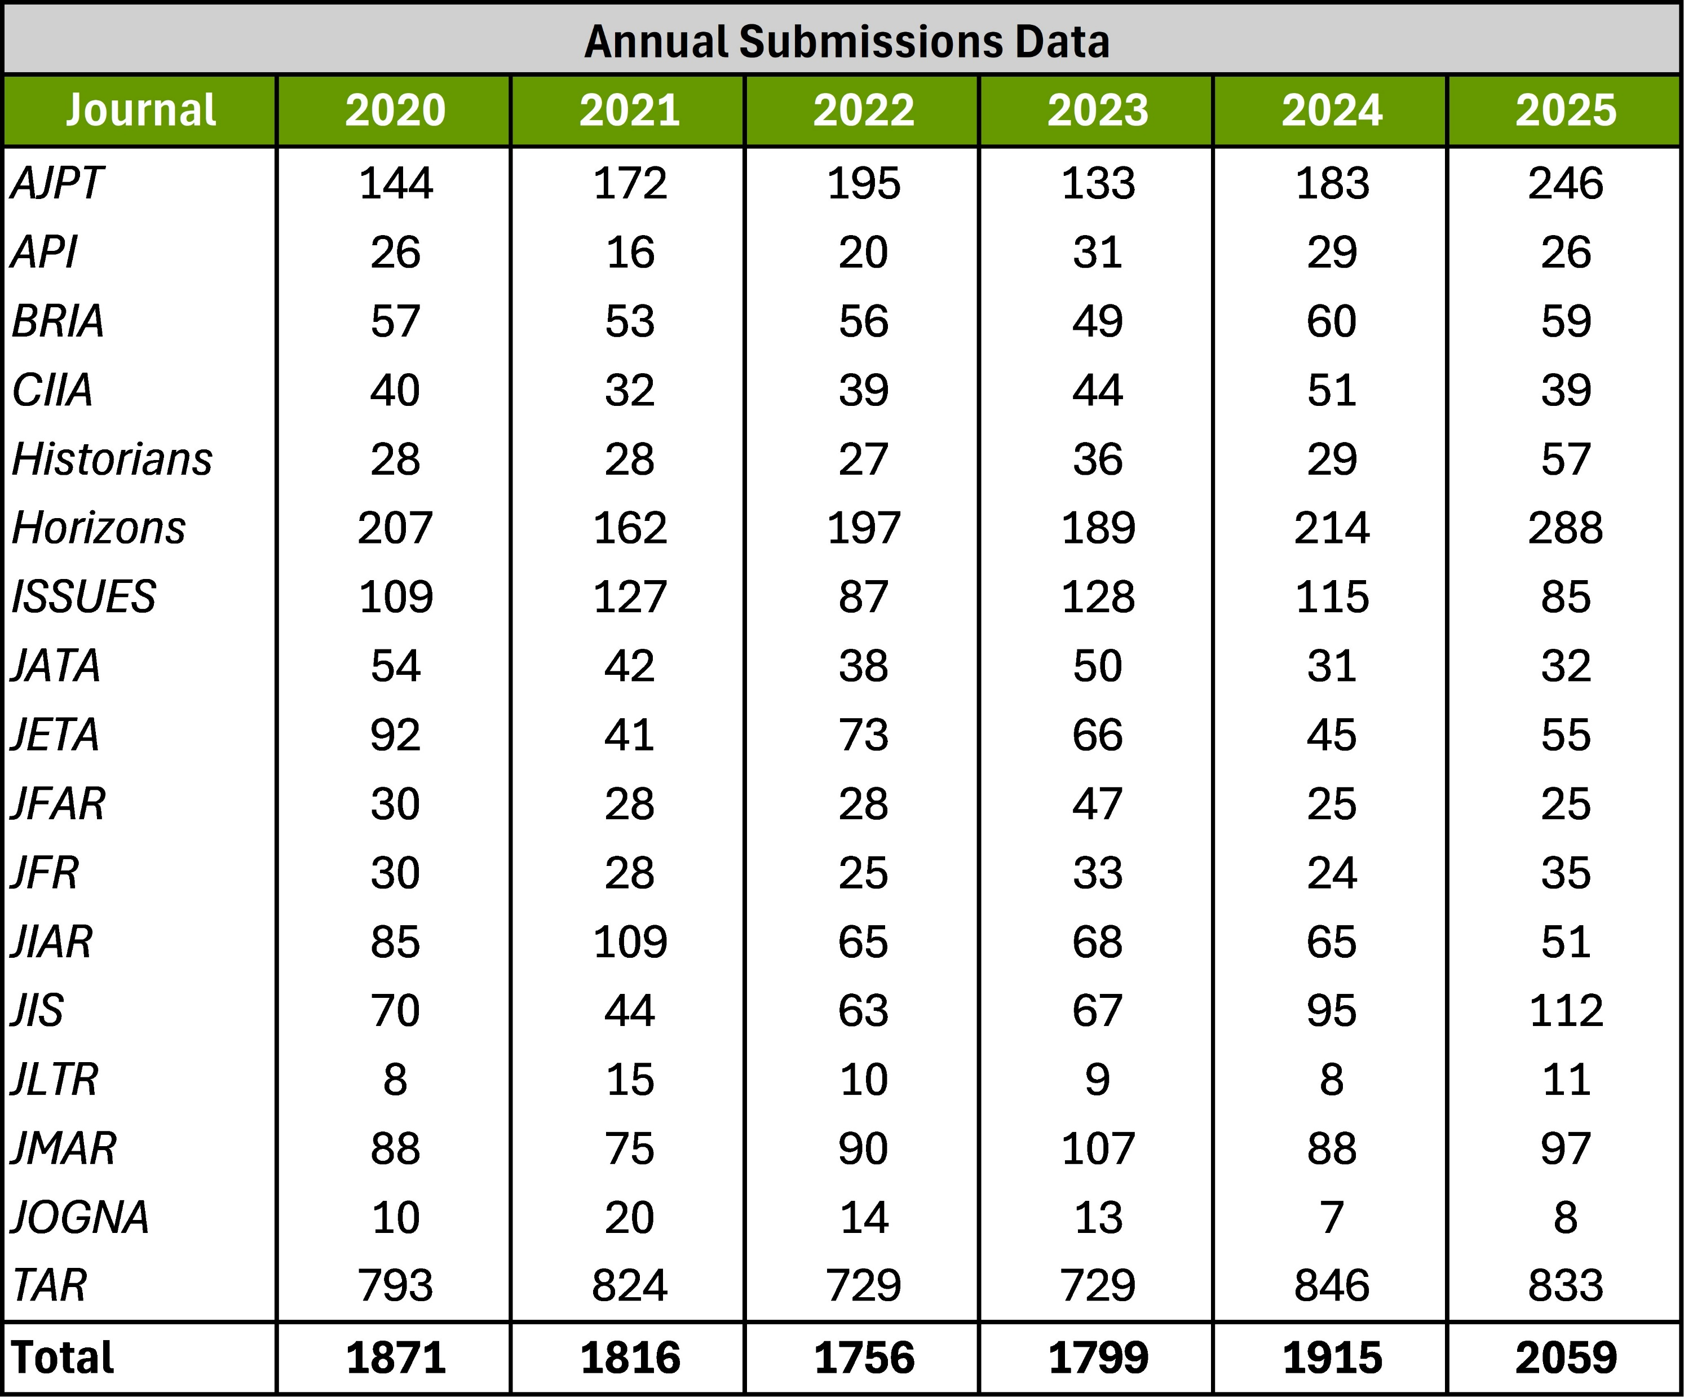
Publications Update

Slide 11
General Membership Outreach Updates
Surveys and Focus Groups
  2x/year across General Membership, PhD Students, Practitioner, Retired groups
Communications
  Email and Social Media campaigns - ongoing
Membership Advisory Committee (MAC)
  AAA Membership Value & Engagement Survey (championed by IMAC)
Targeted Advertising
  Google Grants and Google Paid ads
PropFuel (Micro polls)
  Targeted engagement of non-Section membership
  Renewing / Lapsed Members
  Annual Meeting “Reimagining” feedback

Slide 12
IT /Membership / Marketing Update
New / Updated Websites / Features
  AAAHQ.org major redesign
  Two new COSO Learning Management courses in progress
PropFuel Platform integrated
  Micropolls and short-form engagement
  Membership and Conference focus
    Section Engagement
    Annual Meeting Survey
Migrations / Upgrades
  Section membership online registration live!

Slide 13
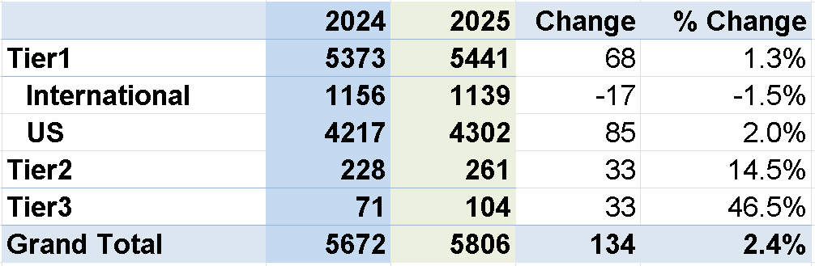
Tiered Membership 2-23-2026

Slide 14
International & Doctoral Students Engagement
AAA-IMA Partnership (MENA)
  Cairo Academic Summit in Egypt (November 2025)
  Professional and Academic Roundtable in Dubai, UAE (January 2026)
  Academic Track - Finance Excellence & Leadership Summit in Dubai, UAE (May 11, 2026)
University/Conference Meetings – MENA Region
  AUC and Cairo University visits, Egypt (November 2025)
  Accounting, Governance & Sustainability (AGS) Conference hosted by KFUPM, KSA (December 2025) & World Continuous Audit & Reporting Symposium hosted by American University of Sharjah, UAE (December 2025)
  UAEU and Zayed University in Dubai, UAE (January 2026)
  King Saud University and Imam University, Riyadh, KSA (Unofficial Visit – February 2026)

Slide 15
International & Doctoral Students Engagement
Global Webinar Series
  Launched in November: Ai in Education, JIAR Editorial Board & AI for Research
SPARK
  Global Faculty-Doctoral Student Interchange Program
  Call for submission – Global and Regional Research and Teaching Topics
  Global times zones
Global Connect
  Global Doctoral Student/Early Career Consortium – Half Day Sunday

Slide 16
Foundation Activities
Two-Year Bridge Symposium
  (2025) Received 1,810 Applications, 32 Offices (Deloitte, PwC, KPMG, EY)
  Finalizing plans for November 2026 (Expansion to Large Regional Firms)
Accounting Hall of Fame
  2026 Inductees Announced (Gene Dodaro, Dan Goelzer, Richard Mattlessich, Bill McCarthy)
  Development of Teaching Resources from 2025 & 2026 Inductee Videos
High School Accounting Course
  Survey in Accounting; Technology Enabled
  Partnering with NBEA, NAF, and Others
  Conducted Interviews with High School Teachers and Developed Survey

Slide 17
Segments Action Items:
February 26th – Section Election Round 2 candidates due
  Round 2 Sections-AAH, ABO, AIS, ATA, EAC FARS, FAS, IAS, Leadership, PIES, SET, TLC
March 3rd – Section Dues and Journal Pricing for 2026-2027 member year.
April 15th – Section Awards at the AAA Global Connect – all award recipients' information due including name, affiliation, paper title & citing if applicable.

Slide 18
Questions?

