Slide 1
Presidents Quarterly Roundtable
May 13, 2026

Slide 2
Agenda
Membership
Governance
Meetings
Center for Advancing Accounting Education
Publications
IT/Marketing
International Membership Updates
Foundation
Segments

Slide 3
Membership - Update
BILL PERIOD | Selected Date | Membership Counts
2026/27 | AS OF 5-12-2026 | 1464
2025/26 | AS OF 5-12-2025 | 532
2025/26 | EOMY | 5974
2024/25 | EOMY | 5827
2023/24 | EOMY | 6179
2022/23 | EOMY | 6273

Slide 4
Section Membership - Update
BILL PERIOD | Selected Date | Membership Counts
2026/27 | AS OF 5-12-2026 | 1637
2025/26 | AS OF 5-12-2025 | 575
2025/26 | EOMY | 7404
2024/25 | EOMY | 7212
2023/24 | EOMY | 7821
2022/23 | EOMY | 8249

Slide 5
General Membership Outreach Updates
Call for Section Recruitment
  Quarterly report-out
  Talking Points
  How to guides (Vignettes): 30-120s micro-videos
Surveys and Focus Groups
Communications
  Email and Social Media campaigns - ongoing
Membership Advisory Committee (MAC)
  AAA Membership Value & Engagement Survey (championed by IMAC)
Targeted Advertising
  Google Grants and Google Paid ads
PropFuel (Micro polls)
  Targeted engagement of non-Section membership
  Renewing / Lapsed Members

Slide 6
Governance Updates
Call for Nominations for 2027-2028 Board Election
  Opening this Summer with the election taking place in early 2027
Upcoming Board and Council Meetings
  Board Strategy (In-Person): May 19 - May 21
  Council (Virtual): July 21
  Board (Virtual): July 20 & July 22

Slide 7
Meetings Update
Global Connect (formerly Annual Meeting)
  Registration is open! Early registration deadline is July 7th!
  Panel Information with date/time of presentations have been sent to all session organizers.
  Session information for all papers and posters will go out on May 22nd.
  Need to hold a committee/journal meeting request at https://aaahq.org/Meetings/2026/AAA-Global-Connect/Event-Request
  Hotel cut-off for reservations is June 26th.
Midyear Meetings
  Meeting Model Committee will meet on June 11 under new Chair Vern Richardson.

Slide 8
Publications Update
The Accounting Review Backfile
  All issues of TAR, going back to the first issue in 1926, have been added to and are now accessible on the Digital Library.
  This project was made possible through a generous contribution by Zoe-Vanna Palmrose through the AAA Foundation.
Open Access
  Twelve AAA journals currently offer Hybrid Gold Open Access, with the Journal of International Accounting Research being added to the list on May 15.
  In March, The Accounting Review published two OA articles, the first for AAA.
Indexing
  Elsevier’s SCOPUS index has agreed to include Journal of Financial Reporting (JFR), which will improve the journal’s profile and submission rate.
Journal Topic Collection
  Journal editors can highlight current and past articles dealing with a specific area of research and present them on a single website.
  Strategy shown to boost citations, particularly of older content.
  First example created for Journal of Information Systems deals with Cybersecurity.

Slide 9
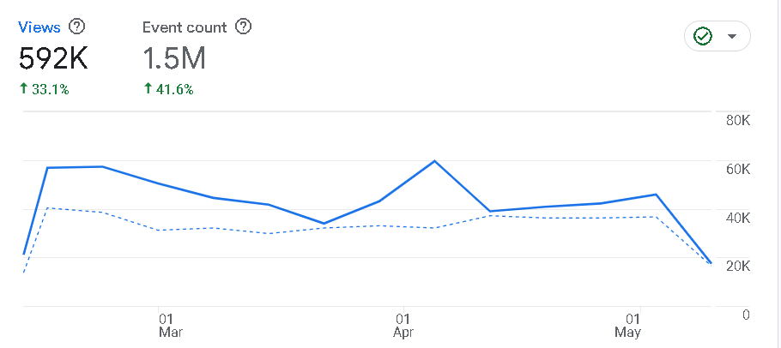
IT /Membership / Marketing Update
New / Updated Websites / Features
  AAAHQ.org major redesign post-launch
    33.1% view increase YOY
Departmental Memberships
  52 invoiced, ~850 memberships
PR Update
PropFuel Platform

Slide 10
International & Doctoral Students Engagement
Global Webinar Series
  Launched in November
  Two Upcoming Webinars in May :
    Monday, May 18 at 10:00 am ET: Introductions, Reviews, and Discussions: A How-To Guide for Early-Career Academics
    Friday, May 22 at 9:00 am ET: How far can we trust AI in the accounting profession and in research?
SPARK
  Global Faculty-Doctoral Student Interchange Program – Fourteen Universities
Global Connect
  Global Doctoral Student Consortium – Half Day Sunday, August 2 (12:00 – 5:00 pm)

Slide 11
Center Update
Pipeline Update
  Update on FASO Working Groups
  Principles Bootcamps / Information Sessions (State Society Outreach – AR, MI & IL)
  Upcoming Panels/Sessions at TACTYC, SPARK, IMA, CTLA, Global Connect
CPE
  Asynchronous (41.6 CPE hours, plus another 30.2 CPE hours from the 2025 Annual Meeting)
  COSO
Webinars
  Booking Webinars - Fall 2026
  May Webinars:
    5/15, (11-12 ET): Adding Value: Why Non-Tenure Track Faculty Positions Deserve a Closer Look
    5/18, (10-11 ET): Introductions, Reviews, and Discussions: A How-To Guide for Early Career Academics
    5/19, (11 -12 ET): Learn More about the DATA and Sustainability Workshops before Global Connect
    5/20, (1-2 ET): Financial Modeling Best Practices Webinar – FMI Sponsored Webinar
    5/22, (9-10 ET): How far can we Trust AI in the Accounting Profession and in Research?

Slide 12
Foundation Activities
Two-Year Bridge Symposium
  November 6, 2026 – Applications Open
  41 Offices (Deloitte, PwC, KPMG, EY, Baker Tilly, BDO, Grant Thornton, RSM, Plant Moran)
  Center for Audit Quality, AGA, IMA, IIA
Accounting Hall of Fame
  2026 Inductees will be Celebrated at 2026 Global Connect
    (2026 Inductees - Gene Dodaro, Dan Goelzer, Richard Mattlessich, Bill McCarthy)
  Teaching Resources Developed from 2025 & 2026 Inductee Videos – April 21st Webinar
High School Accounting Course
  Survey in Accounting; Technology Enabled
  Partnering with NBEA, NAF, and Others
  Conducted Interviews with High School Teachers & Developed Survey to Identify Needs

Slide 13
Questions?

