Slide 1
Presidents Quarterly Roundtable
May 9, 2024

Slide 2
Agenda
Membership
Finance Update
Board Retreat & Meeting
AAA Facilities Update
Director Focusing on Segments Update
Segment Leaders Updates
Meetings Updates
Center for Advancing Accounting Education Updates
IT/Membership/Marketing Update
Publications Updates
Sponsorships/Foundation Updates
Open Conversation/Questions

Slide 3
Membership
BILL PERIOD | Selected Date | Membership Counts
2024/25 | AS OF 5-8-2024 | 801
2023/24 | AS OF 5-8-2023 | 723
2023/24 | EOMY | 6144
2022/23 | EOMY | 6271
2021/22 | EOMY | 6601
2020/21 | EOMY | 6217

Slide 4
Section Membership
BILL PERIOD | Selected Date | Membership Counts
2024/25 | AS OF 5-8-2024 | 905
2023/24 | AS OF 5-8-2023 | 870
2023/24 | EOMY | 7821
2022/23 | EOMY | 8249
2021/22 | EOMY | 8643
2020/21 | EOMY | 8255

Slide 5
Finance Update
Finance Outsourcing Underway (Kaiser Consulting)
  Section financials tomorrow
  Challenges with systems
BAP Integrated May 1
  Also using Kaiser
  Providing IT and Meetings services as well
  Attending part of Board Retreat

Slide 6
Board Retreat & Meeting
Orlando May 20-23
Main Topics:
  Membership Journey Maps for 8 categories
  Updates on 2030 Strategic Plan (initiated in 2022)
  Meetings Discussions
  120/150 Movements and Impact on Higher Ed
  AAA/BAP Synergies

Slide 7
Facilities Update
AAA Building
  Currently three Interested parties
Goals
  Reduce staff time spent on facilities
  Create a more collaborative space
  Reduce overhead expenses
  Take advantage of FL market increases

Slide 8
Section Action Items
May 2024
May 21st - Round 2 Section election voting closes
Annual Meeting - Submitting paper authors and panel organizer must confirm their presentation and update their submission information to be included on the meeting program. Panels are finalized.
June 2024
Section Volunteer Directory - continue work on populating open Section volunteer positions. Directory due July 15th.
Review all Section financials from the year and submit questions you will need answered for reporting at your Executive Committee meeting at the Annual Meeting.
July 2024
July 15th annually - Section Volunteer Directory due to Shauna
Q4 Section Financial Reports sent out to Sections
President & Chair Elects - begin thinking about your letter to post and send out to Section members in late August/early September.

Slide 9
Meetings Update
Midyear Meetings
Location Selection Reminders 2025 & 2026
Meetings Model Committee Update
Annual Meeting 2024
Registration is Open!
Paper/Panel Notices are out!
Hotel Room Blocks Deadline July 22nd!

Slide 10
Center Update - Webinar Series
weARE Webinars
  Scheduling from August forward
  Upcoming May Webinar: Friday, 5/14/24, 11:00 am – 12:00 pm EST
    From Courtroom to Boardroom: Stakeholder Communications in Financial Litigation Reporting
    https://aaahq.org/Education/Resources/Online/weARE-Webinar-97

Slide 11
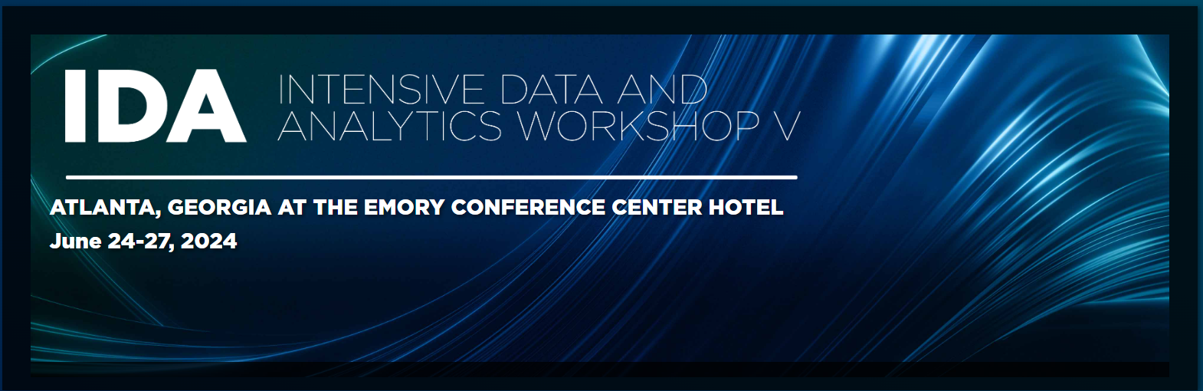
Center Update
Intensive Data and Analytics Workshop V
    June 24-27th at the Emory Conference Center Hotel
    Program Changes
      Full day of training on Monday
      Both beginner and intermediate tracks for participants
CHANGES FOR 2024
The entire day on Monday will be devoted to introductory and intermediate levels of training on specific technologies and software packages featured at the conference.
The program throughout the week will have beginner and intermediate tracks based on technologies and software packages. There will also be some advanced sessions throughout the program.

Slide 12

Center Update
Strategies for Success in the Classroom
    June 10th and 11th at Bentley University
    Workshop Facilitators:
      Dr. Jay Thibodeau, Bentley University
      Karen Osterheld, AAA

Slide 13
Center Update
Pipeline Working Groups
Principles Course
Branding
Community Colleges
High Schools

Slide 14
Information Technology/Membership/Marketing Update
Marketing Update
  Campaigns for Membership and Annual Meeting are underway
  Social media refresh / revitalization
Advertising
  Availability on AAA websites
  Google Grant update
Call for Support: Pledge to Like, Repost on LI, FB, and X
LMS: Resource Repository in development
Notes:
Kelsey Brasel and Jason

Slide 15
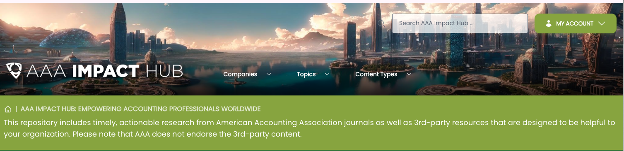
Publications Update
Publications Ethics policies for the use of AI-generative tools.
Media Database – let us know if you are interested in speaking with the media!
Forthcoming: Financial and Activities COI form for journal submission; Journal homepages with easier navigation and consolidated policies.
AAA IMPACT Hub. (launched April 16) Plain Language Summaries summaries & Infographics highlight research with societal impact. Podcasts & webinars are in the works!

Slide 16

Sponsorships and Foundation Update
Midyear and Annual Meeting Sponsors and Exhibitors
  Recommendations
  Ongoing Relationships
  Steve.Matzke@aaahq.org
The American Accounting Association Foundation
  Communications
  Board of Trustees Meeting
  Programming
    The Accounting Hall of Fame
    High School Accounting Course
    Other Programming

Slide 17
Questions?

Slide 18
Thank you!
Yvonne.Hinson@AAAHQ.ORG

