Slide 1
Presidents Quarterly Roundtable
July 2023

Slide 2
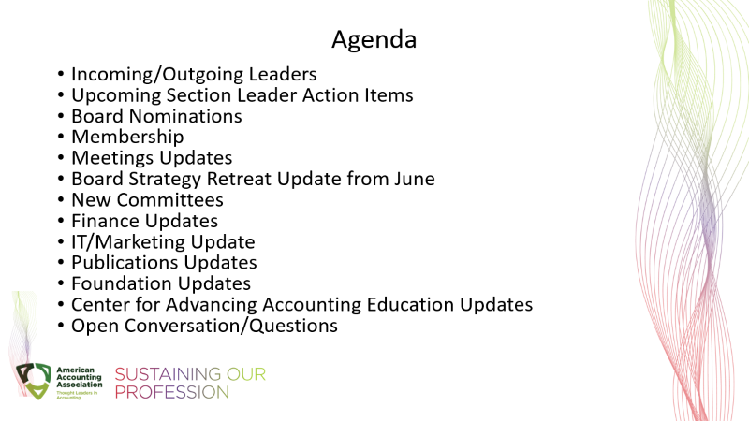
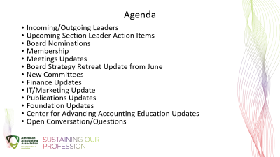
Agenda
Incoming/Outgoing Leaders
Upcoming Section Leader Action Items
Board Nominations
Membership
Meetings Updates
Board Strategy Retreat Update from June
New Committees
Finance Updates
IT/Marketing Update
Publications Updates
Foundation Updates
Center for Advancing Accounting Education Updates
Open Conversation/Questions

Slide 3
Upcoming Action Items:
July:
President-Elect, Chair-Elect and Vice President-Academic – continue populating your Section member volunteer directory for 2023-2024. Information due no later than Thursday, August 10th.
August:
Presidents/Chairs letters due to post on Section websites and send out in emails to your members in September.
Incoming Segment Leaders:
https://aaahq.org/SegmentLeaders

Slide 4

Three Open Board Positions for 2024-2025
President-Elect
Vice President-Research & Publications
Director-Focusing on Segments*
* This Director position will be chosen for the Slate by the Council Ballot Committee (CBC), comprised of all Council except for the Board of Directors, in November; however, the AAA Nominations Committee is responsible for nominating candidates for this position.

Slide 5
Membership
BILL PERIOD | Selected Date | Membership Counts
2023/24 | AS OF 5/3/2023 | 605
2022/23 | AS OF 5/3/2022 | 303
2022/23 | EOMY | 6271
2021/22 | EOMY | 6601
2020/21 | EOMY | 6217
2019/20 | EOMY | 7154

Slide 6
Section Membership
BILL PERIOD | Selected Date | Membership Counts
2023/24 | AS OF 5/3/2023 | 708
2022/23 | AS OF 5/3/2022 | 413
2022/23 | EOMY | 8249
2021/22 | EOMY | 8643
2020/21 | EOMY | 8255
2019/20 | EOMY | 9157

Slide 7
Meetings Updates
Annual Meeting & CTLA
Section marketing for mid-year meetings
Submission System costs
APP costs

Slide 8
Board Strategy Retreat
DEIB Training
Planning for Accounting Pipeline Stakeholder Symposium - Washington, DC - September 28-29, 2023; co-hosted with NABA
Voice of the AAA
Vision 2030 Strategy Update from May 2022
DEIB and how federal/state decisions may impact the AAA efforts
Membership Discussion
Decisions for Board over next year (Building, # Segments, Meetings)
Board approved a New Section Policy that engages Council

Slide 9
New Committees
Section Advisory Committee – developed out of Publications Processes Task Force
Thought Leaders Editorial Advisory Committee

Slide 10
Finance Update
Fiscal year end audit starts last week of July
Preliminary May 31, 2023 (fiscal year end) financials will be distributed the beginning of August with current treasurer’s guidebook to enable review of the year end statements
New guidebook will be issued with the first quarter (2024) financial statements for the publications and meetings taskforce changes

Slide 11
Information Technology/Marketing Update
Submission System Update
Marketing Update
  Marketing Communications Manager
  Marketing Firm – Management Team Approved
LMS Update

Slide 12
Publications Update
Meetings with Sections with Journals based on impact:
  Sections with journals with positive or no impact from new model
  Sections with multiple journals
  Sections with journals negatively impacted from new model

Slide 13
The AAA Foundation Update (Confidential)
Update on Activities
  AAA Board approved slate of Trustees
  George Krull will be the first Chair of the AAA Foundation
  Legal Filings
AAA Annual Meeting
  Announcement
  Board Meeting

Slide 14
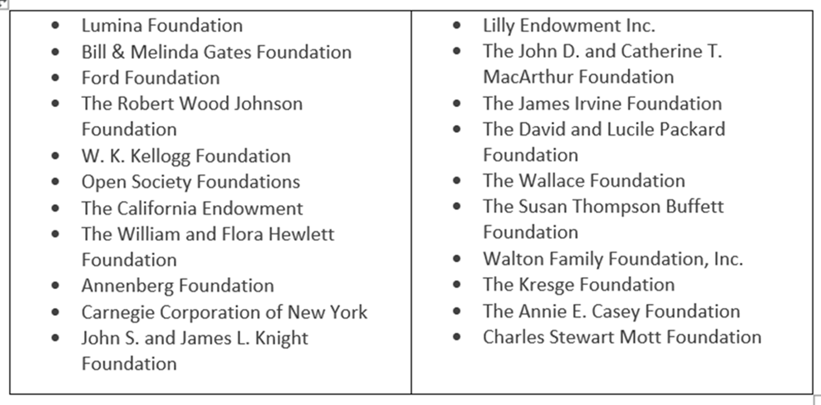
AAA Foundation Funding
Grants
Planned Giving
Annual Giving (Giving Tuesday)
Other opportunities?

Slide 15
The Inclusive Classroom Certificate
Foundational Module
  Where do I Start? A Pathway for Personal Growth for Faculty Committed to Creating Inclusive Classrooms. Issues in Accounting Education (Bishop-Monroe, R., & Garcia, J. L., 2023
Other Modules
  A Look Back and a Look Forward - Discussing the Historical Perspective of the Accounting Profession
  Inclusive Syllabi
  LGBTQ+ Aspects of Classroom Inclusivity, Including Pronoun Usage
  Leveraging Technology to Create an Equitable and Inclusive Learning Environment
  Addressing Subtle Bias in Classroom Dynamics

Slide 16
Webinar Series on the Pipeline
Results of New CAQ Research on Students’ Perceptions about the Accountancy Major and Motivations in Selecting a Career Path - 9/12/23
Recruiting Students from Under-Represented Populations to the Accountancy Major – Held on 5/31/23
Best Practices for the Introductory Accounting Course Sequence– Held on 4/4/23
Strategies for Increasing the Pipeline of Accounting Students – Held on 1/4/23

Slide 17
Questions?

Slide 18
Thank you!
Yvonne.Hinson@AAAHQ.ORG

